Slide 1
Linked Bernoulli Synopses Sampling Along Foreign Keys Rainer Gemulla, Philipp Rösch, Wolfgang Lehner Technische Universität Dresden
Faculty of Computer Science, Institute for System Architecture, Database Technology Group

Slide 2
Outline
Introduction
Linked Bernoulli Synopses
Evaluation
Conclusion

Slide 3
Motivation
Scenario
Schema with many foreign-key related tables
Multiple large tables
Example: galaxy schema
Goal
Random samples of all the tables (schema-level synopsis)
Foreign-key integrity within schema-level synopsis
Minimal space overhead
Application
Approximate query processing with arbitrary foreign-key joins
Debugging, tuning, administration tasks
Data mart to go (laptop) → offline data analysis
Join selectivity estimation

Slide 4
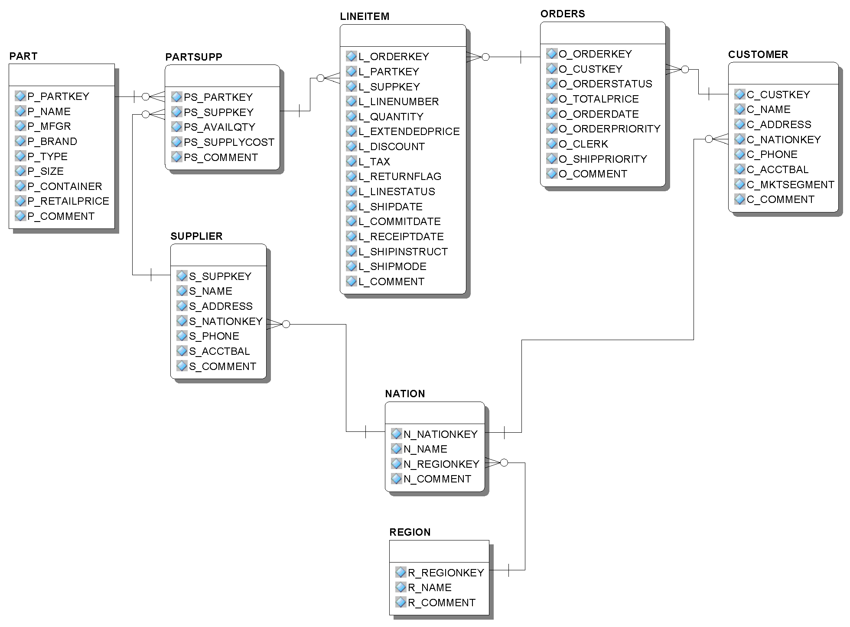
Example: TPC-H Schema
sales of part X
Customers with positive balance
Suppliers from ASIA
Notes:
APQ: money made with part X
Join selectivity: #lineitems with part X

Slide 5
Known Approaches
Naïve solutions
Join individual samples → skewed and very small results
Sample join result → no uniform samples of individual tables
Join Synopses [AGP+99]
Sample each table independently
Restore foreign-key integrity using “reference tables”
Advantage
Supports arbitrary foreign-key joins
Disadvantage
Reference tables are overhead
Can be large
[AGP+99] S. Acharya, P.B. Gibbons, and S. Ramaswamy.
Join Synopses for Approximate Query Answering. In SIGMOD, 1999.
Notes:
only tuples of the samples may directly be used for approximate query processing → tuples of reference tables = overhead

Slide 6
Join Synopses – Example
Table A
Table B
Table C
PK | FK
a₁ | b₁
a₂ | b₂
a₃ | b₄
a₄ | b₄
PK | FK
a₁ | b₁
a₂ | b₂
a₃ | b₄
a₄ | b₄
PK | FK
b₁ | c₁
b₂ | c₁
b₃ | c₃
b₄ | c₄
PK | FK
b₁ | c₁
b₂ | c₁
b₃ | c₃
b₄ | c₄
PK
c₁
c₂
c₃
c₄
PK
c₁
c₂
c₃
c₄
50%
sample
Ψ_{A}
Ψ_{B}
Ψ_{C}
PK | FK
a₂ | b₂
a₄ | b₄
PK | FK
b₂ | c₁
b₃ | c₃
PK
c₁
c₂
PK | FK
PK | FK
PK
sample
?
?
b₄ | c₄
reference table
?
c₃
c₄
50% overhead!
Notes:
Coin-flip sampling
expected overhead is 33.85% (expected synopsis size is 8.03125)

Slide 7
Outline
Introduction
Linked Bernoulli Synopses
Evaluation
Conclusion

Slide 8
Linked Bernoulli Synopses
Observation
Set of tuples in sample and reference tables is random
Set of tuples referenced from a predecessor is random
Key Idea
Don’t sample each table independently
Correlate the sampling processes
Properties
Uniform random samples of each table
Significantly smaller overhead (can be minimized)
Table A
Table B
PK | FK
a₁ | b₁
a₂ | b₂
a₃ | b₃
PK
b₁
b₂
b₃
1:1 relationship
Notes:
Samples are dependent, but that doesn’t matter for queries
Re-use the randomness of sampling the predecessor
Bias the sample towards the referenced tuples

Slide 9
Algorithm
Process the tables top-down
Predecessors of the current table have been processed already
Compute sample and reference table
For each tuple t
Determine whether tuple t is referenced
Determine the probability pRef(t) that t is referenced
Decide whether to
Ignore tuple t
Add tuple t to the sample
Add tuple t to the reference table
“t is selected”
Notes:
Decision might be randomized

Slide 10
Algorithm (2)
Decision: 3 cases
pRef(t) = q
t is referenced: add t to sample
otherwise: ignore t
pRef(t) < q
t is referenced: add t to sample
otherwise: add t to sample with probability
(q – pRef(t)) / (1 – pRef(t)) (= 25%)
pRef(t) > q
t is referenced: add t to sample with probability q/pRef(t) (= 66%) or to the reference table otherwise
t is not referenced: ignore t
Note: tuples added to reference table in case 3 only
50%
50%
t
50%
33%
t
50%
75%
t
Notes:
25%
66%

Slide 11
Example
Table A
Table B
Table C
PK | FK
a₁ | b₁
a₂ | b₂
a₃ | b₄
a₄ | b₄
PK | FK
a₁ | b₁
a₂ | b₂
a₃ | b₄
a₄ | b₄
PK | FK
b₁ | c₁
b₂ | c₁
b₃ | c₃
b₄ | c₄
PK
c₁
c₂
c₃
c₄
PK
c₁
c₂
c₃
c₄
case 1 (=)
not referenced
→ ignore tuple
50%
b₁ | c₁
50%
75%
case 3 (>)
case 1
referenced
→ add to sample
b₂ | c₁
case 2 (<)
not referenced
→ add to sample with probability 50%
→ ignore tuple with probability 50%
b₂ | c₁
50%
b₂ | c₁
50%
case 2 (<)
case 3 (>)
referenced
→ add to sample with probability 66%
add to reference table with
probability 33%
50%
b₃ | c₃
50%
case 1 (=)
50%
b₄ | c₄
case 3 (>)
75%
b₄ | c₄
75%
50%
sample
Ψ_{A}
Ψ_{B}
Ψ_{C}
PK | FK
PK | FK
PK
c₂
c₄
PK
a₂ | b₂
a₄ | b₄
b₂ | c₁
b₄ | c₄
c₁
overhead reduced
to 16.7%!
Notes:
expected overhead is 12.5% (expected synopsis size is 6.75)
example instance: overhead reduced from 50% to 16.7% ➔ 66,66% less overhead
expected overhead: overhead reduced from 33.85% to 12.5% ➔ 63% less overhead

Slide 12




Computation of Reference Probabilities
General approach
For each tuple, compute the probability that it is selected
For each foreign key, compute the probability of being selected
Can be done incrementally
Single predecessor (previous examples)
References from a single table
Chain pattern or split pattern
Multiple predecessors
references from multiple tables
Independent references
merge pattern
Dependent references
diamond pattern
Notes:
Selected = sample or reference table

Slide 13
Diamond Pattern
Diamond pattern in detail
At least two predecessors of a table share a common predecessor
Dependencies between tuples of individual table synopses
Problems
Dependent reference probabilities
Joint inclusion probabilities

Slide 14
Diamond Pattern - Example
Table B
PK | FK
b₁ | d₁
b₂ | d₂
b₃ | d₃
Table A
Table D
PK | FK_{B} | FK_{c}
a₁ | b₁ | c₁
a₂ | b₂ | c₃
a₃ | b₃ | c₂
PK
d₁
d₂
d₃
Table C
PK | FK
c₁ | d₁
c₂ | d₂
c₃ | d₃

Slide 15
Diamond Pattern – Example
Table B
PK | FK
b₁ | d₁
b₂ | d₂
b₃ | d₃
Dep. reference probabilities
tuple d₁ depends on b₁ and c₁
Assuming independence: pRef(d₁)=75%
b₁ and c₁ are dependent
pRef(d₁)=50%
Table A
50%
Table D
50%
PK | FK_{B} | FK_{c}
a₁ | b₁ | c₁
a₂ | b₂ | c₃
a₃ | b₃ | c₂
PK
d₁
d₂
d₃
Table C
50%
50%
PK | FK
c₁ | d₁
c₂ | d₂
c₃ | d₃
Notes:
Both or none

Slide 16
Diamond Pattern - Example
Table B
PK | FK
b₁ | d₁
b₂ | d₂
b₃ | d₃
Joint inclusions
Both references to d₂ are independent
Both references to d₃ are independent
But all 4 references are not independent
d₂ and d₃ are always referenced jointly
Table A
Table D
PK | FK_{B} | FK_{c}
a₁ | b₁ | c₁
a₂ | b₂ | c₃
a₃ | b₃ | c₂
PK
d₁
d₂
d₃
Table C
PK | FK
c₁ | d₁
c₂ | d₂
c₃ | d₃

Slide 17
Diamond Pattern
Diamond pattern in detail
At least two predecessors of a table share a common predecessor
Dependencies between tuples of individual table synopses
Problems
Dependent reference probabilities
Joint inclusion probabilities
Solutions
Store tables with (possible) dependencies completely
For small tables (e.g., NATION of TPC-H)
Switch back to Join Synopses
For tables with few/small successors
Decide per tuple whether to use correlated sampling or not (see full paper)
For tables with many/large successors
Notes:
Switch back to JS for tables with dependencies and all its successors

Slide 18
Outline
Introduction
Linked Bernoulli Synopses
Evaluation
Conclusion

Slide 19
Evaluation
Datasets
TPC-H, 1GB
Zipfian distribution with z=0.5
For values and foreign keys
Mostly: equi-size allocation
Subsets of tables

Slide 20
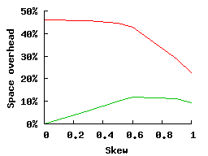
Impact of skew
Tables: ORDERS and CUSTOMER
varied skew of foreign key from 0 (uniform) to 1 (heavily skewed)
JS
TPC-H, 1GB
Equi-size allocation
LBS
Notes:
JS have a high overhead
on uniformly distributed keys, but the overhead decreases with increasing skew.
The reason for this behavior is that, when the skew is low, almost every tuple
in the sample of O corresponds to a different customer, which in turn has to
be added to the reference table. When the skew is high, however, a large subset
of the orders are placed by only a small subset of the customers; the number
of distinct foreign keys in the sample of O therefore decreases in expectation.
The overhead of LBS is consistently smaller than the overhead of JS. For a skew
value of z = 0, no reference tables are needed at all; see the discussion at the end
of Section 4.2. With increasing skew, some tuples are referenced with a higher
probability than their desired sampling rate (case 3), so that they are added to
the reference tables from time to time. If the skew increases further, the number
of referenced tuples decreases rapidly and the same effect as for JS can be
observed.

Slide 21
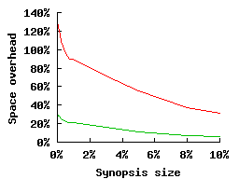
Impact of synopsis size
Tables: ORDERS and CUSTOMER
varied size of sample part of the schema-level synopsis
JS
LBS
Notes:
In a final experiment, we evaluated the impact of the synopsis
size when sampling the 6 tables mentioned above. Figure 7c plots the space
overhead in dependency of the size of the sample part of the synopsis. As can
be seen, the overhead decreases with increasing sample size because more and
more tuples qualify for the sample and therefore do not have to be stored in the
reference tables. Especially for small synopses, LBS have a significantly smaller
overhead.

Slide 22
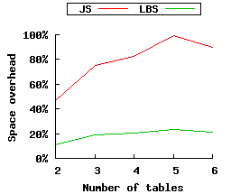
Impact of number of tables
Tables
started with LINEITEMS and ORDERS, subsequently added CUSTOMER, PARTSUPP, PART and SUPPLIER
shows effect of number transitive references
Notes:
We next evaluated the impact of the number of tables. We
started with just lineitem and orders and subsequently added customer, partsupp,
part and supplier (in this order). The total size of the synopsis was set to
1%. The skew parameter was set to z = 0.5. The results are shown in Figure 7b.
As can be seen, LBS outperform JS, especially when the number of tables is
high. The reason is that an increasing number of tables lead to an increasing
number of transitive references, which have to be stored in the reference tables.
For Linked Bernoulli Synopses, this effect is reduced to a minimum.

Slide 23
Outline
Introduction
Linked Bernoulli Synopses
Evaluation
Conclusion

Slide 24
Conclusion
Schema-level sample synopses
A sample of each table + referential integrity
Queries with arbitrary foreign-key joins
Linked Bernoulli Synopses
Correlate sampling processes
Reduces space overhead compared to Join Synopses
Samples are still uniform
In the paper
Memory-bounded synopses
Exact and approximate solution

Slide 25
Thank you!
Questions?

Slide 26
Linked Bernoulli Synopses Sampling Along Foreign Keys Rainer Gemulla, Philipp Rösch, Wolfgang Lehner Technische Universität Dresden
Faculty of Computer Science, Institute for System Architecture, Database Technology Group

Slide 27
Backup:
Additional Experimental Results

Slide 28
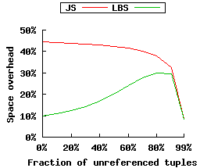
Impact of number of unreferenced tuples
Tables: ORDERS and CUSTOMER
varied fraction of unreferenced customers from 0% (all customers placed orders) to 99% (all orders are from a small subset of customers)
Notes:
In the next experiment, we proceeded as
before but modified the fraction f of unreferenced customers. A fraction of f =
40% means that 40% of the customers did not place any order. For the remaining
customers, we used a skew parameter of z = 0.5. Figure 7d plots the space
overhead for various choices of f. For JS, the space overhead decreases as the
f increases. The reason is that the number of distinct customers in the sample
of O drops as f increases so that less space is required for reference tables. LBS
performs better when the values of f are not too extreme. When the value of
f increases, so does the space overhead because more and more customers are
referenced with probability larger than the sampling fraction (case 3).

Slide 29
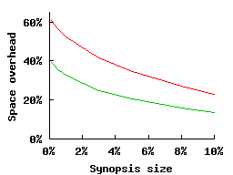
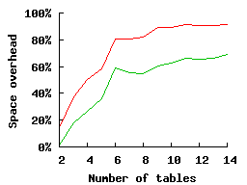
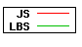
CDBS Database
C
large number
of unreferenced
tuples (up to 90%)

Slide 30
Backup:
Memory bounds

Slide 31
Memory-Bounded Synopses
Goal
Derive a schema-level synopsis of given size M
Optimization problem
Sampling fractions q₁,…,q_{n} of individual tables R₁,…,R_{n}
Objective function f(q₁,…,q_{n})
Derived from workload information
Given by expertise
Mean of the sampling fractions
Constraint function g(q₁,…,q_{n})
Encodes space budget
g(q₁,…,q_{n}) ≤ M (space budget)
Notes:
sth about equi-sampling-fraction scheme?

Slide 32
Memory-Bounded Synopses
Exact solution
f and g monotonically increasing
Monotonic optimization [TUY00]
But: evaluation of g expensive (table scan!)
Approximate solution
Use an approximate, quick-to-compute constraint function
g_{l}(q₁,…,q_{n}) = |R₁|∙q₁ + … + |R_{n}|∙q_{n}
ignores size of reference tables
lower bound → oversized synopses
very quick
When objective function is mean of sampling fractions
q_{i} ∝ 1/|R_{i}|
equi-size allocation
[TUY00] H. Tuy. Monotonic Optimization: Problems and Solution approaches. SIAM J. on Optimization, 11(2): 464-494, 2000.
Notes:
optional: second run to adapt size of oversized synopses

Slide 33
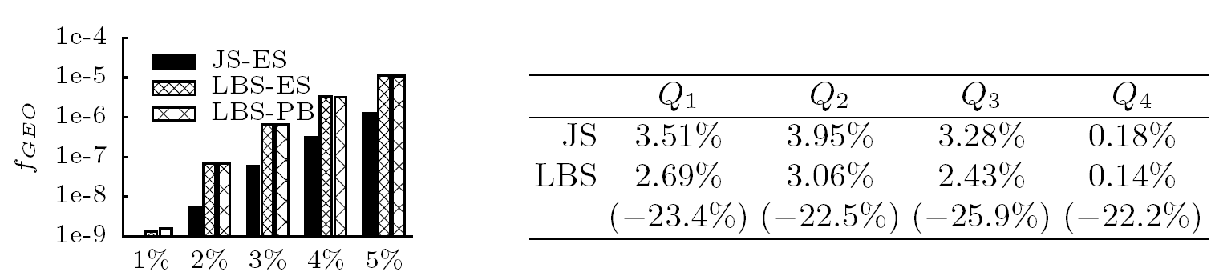
Memory Bounds: Objective Function
Memory-bounded synopses
All tables
computed f_{GEO} for both JS and LBS (1000 it.) with
equi-size approximation
exact computation
Notes:
improvement when run longer, but EXPENSIVE
Currently inverstigating more recent methods for monotonic optimization

Slide 34
Memory Bounds: Queries
Example queries
1% memory bound
Q₁: average order value of customers from Germany
Q₂: average balance of these customers
Q₃: turnover generated by European suppliers
Q₄: average retail price of a part
Notes:
Average relative error

