Slide 1
Sampling Time-Based
Sliding Windows in Bounded Space
Rainer Gemulla
Wolfgang Lehner
Technische Universität Dresden
Faculty of Computer Science, Institute of System Architecture, Database Technology Group

Slide 2
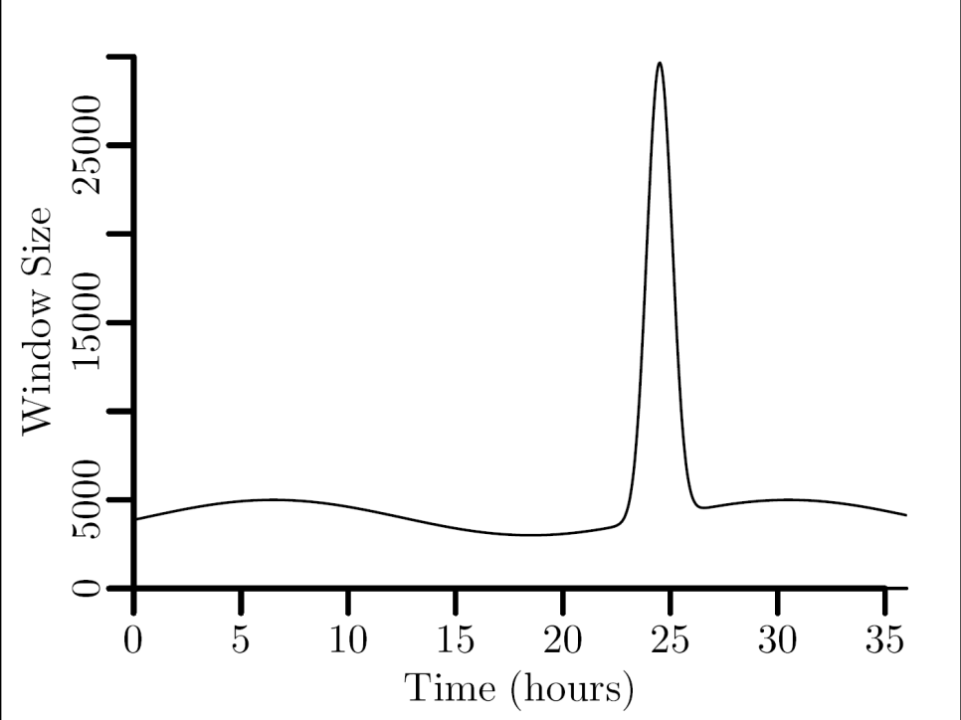
Motivation: Ad-hoc Queries
Query a data stream
  SELECT SUM(size) AS num_bytes
  FROM packets [Range 60 Minutes]
window width
(fixed)
synthetic sine curve (24h)
plus peak
window size
(varying)
Notes:
Example: Car traffic, sensor data

Slide 3
Sampling Time-Based Windows
Approaches
  Exact: Store entire window
  Approximate
    Use specialized synopses
    Random sampling
Challenges
  Preserve uniform sampling characteristics
    Ensure statistical correctness
  Consider space bounds
    Effective resource management
  Maximize sample size
    Achieve best possible estimates
Notes:
Uniform → samples of equal size are equally likely

Slide 4
Outline
Introduction
Available Schemes
Bounded Priority Sampling
Analysis & Experimental Results
Conclusion

Slide 5
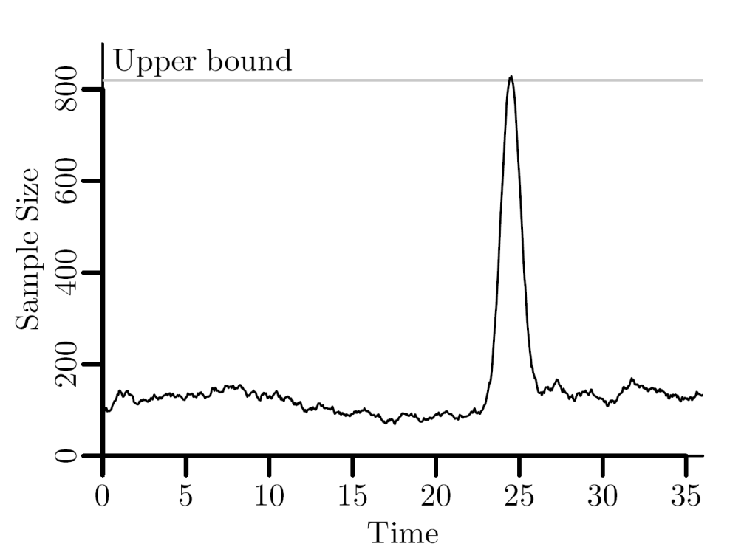
Existing Techniques
Bernoulli sampling (coin-flip sample)
  each item is included with probability q (=sampling rate)
  sample size is qN in expectation, where N is window size
  not a bounded-space scheme
  Example: 40byte items, 32kbyte space → max 819 items
q = 0.0276

Slide 6
Existing Techniques
Priority sampling
  Assigns a random priority to each arriving item
  Item with the highest priority = random sample of size 1
  Larger samples → multiple copies
  O(log N) items in expectation → unbounded
Brian Babcock, Mayur Datar, and Rajeev Motwani. Sampling from a moving window over streaming data. In Proc. SODA, pages 633–634, 2002.
Notes:
Brian Babcock, Mayur Datar, Rajeev Motwani in SODA 2002= ACM SIAM Symposium on Discrete Algorithms
Multiple independent copies for larger samples
Based on min-wise sampling:
C. T. Fan, Mervin E. Muller, Ivan Rezucha
Development of Sampling Plans by Using Sequential (Item by Item) Selection Techniques and Digital Computers
JASA, 1962

Slide 7

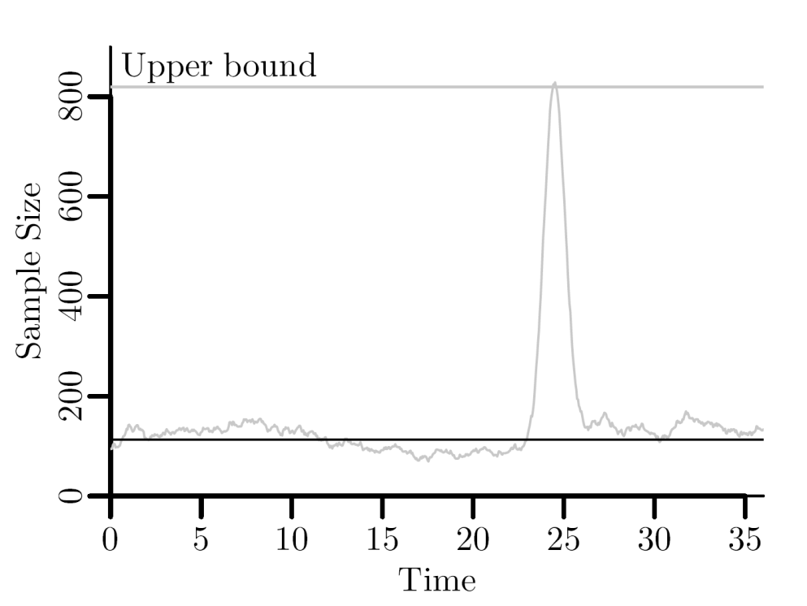
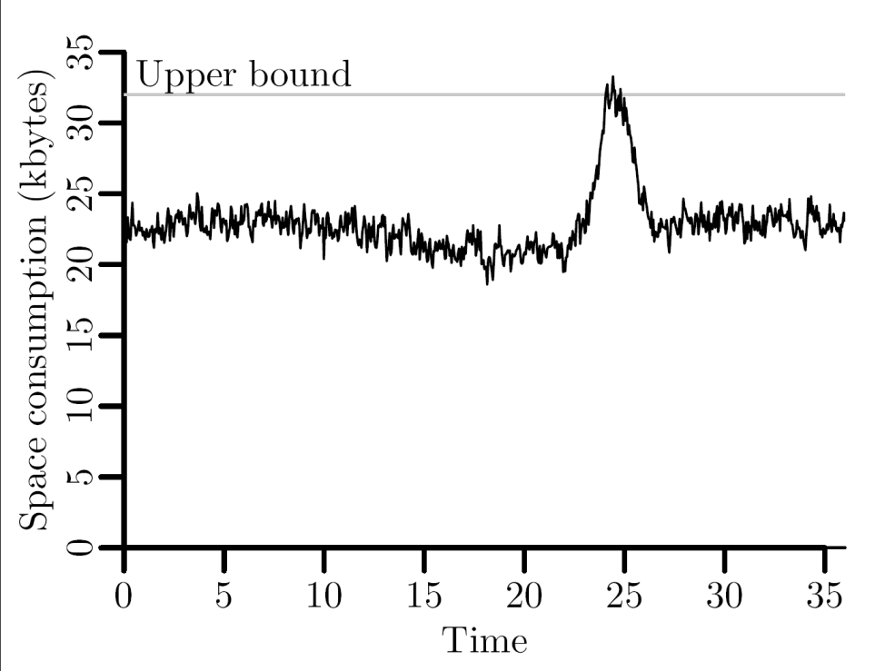
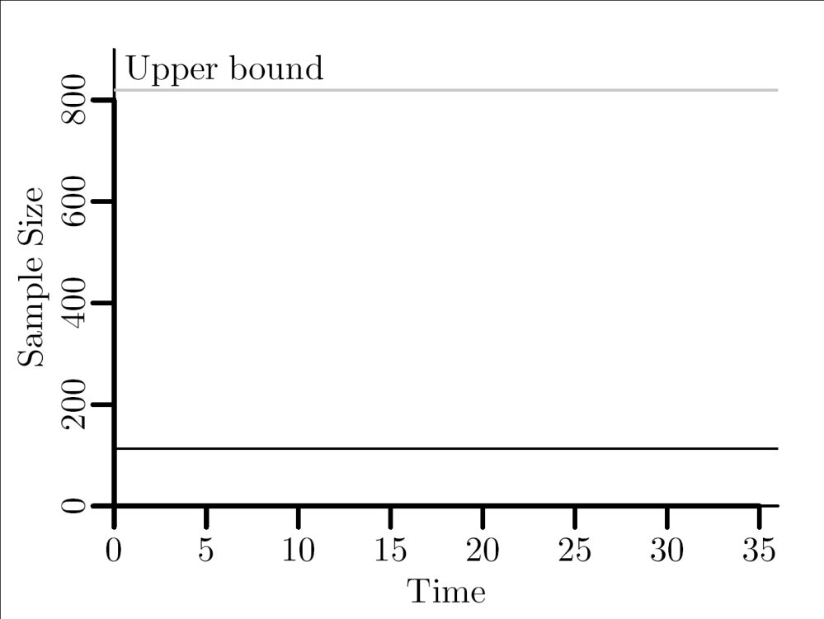
Example: Priority Sampling
Sample size
Sample space
k = 113 items

Slide 8
Sample Synopsis
  Sample size
  Fixed
  Bounded
  Unbounded
  Sample space
  Bounded
  Unbounded
Overhead
Sample
 | Size
 | Fixed | Bounded | Unbounded
Bounded | ??? | ??? | N/A
Unbounded | Priority | ― | Bernoulli
Space

Slide 9
Outline
Introduction
Existing Techniques
Bounded Priority Sampling
Analysis & Experimental Results
Conclusion

Slide 10
A Negative Result
Fixed sample size in bounded space → impossible
  Sample size 1
  I_{j} = item j reported at time j
  Different items: at least ΣI_{j}
  Expected: E[ΣI_{j}] = ΣE[I_{j}] = 1+1/2+…+1/N = O(log N)
  Worst case ≥ average case
  Event:
  Probability:
  I₁
  1/N
  I₂
  1/(N-1)
...
  I_{N-1}
  1/2
  I_{N}
  1
Notes:
Assumption: no new items inserted
It follows that it is impossible to guarantee a minimum sample size
Priority sampling is asymptotically optimal

Slide 11
Sample Synopsis
  Sample size
  Fixed
  Bounded
  Unbounded
  Sample space
  Bounded
  Unbounded
Overhead
Sample
 | Size
 | Fixed | Bounded | Unbounded
Bounded | N/A | ??? | N/A
Unbounded | Priority | ― | Bernoulli
Space

Slide 12
Bounded Priority Sampling
Data structure
  Candidate = highest-priority item since last expiration
  Test item = expired candidate
Sample extraction
  No test item: REPORT
  Candidate < Test: DO NOT REPORT
  Candidate > Test: REPORT

Slide 13
Proof of Correctness
Outline
  e_{max}: the highest-priority item in the window (random)
  e′: candidate at start of current window (now expired)
  It can be shown that
  Does not depend on position of item in stream
  Thus: P(S={e_{j}} | |S|=1) = P(e_{j}=e_{max}) = 1/N

Slide 14
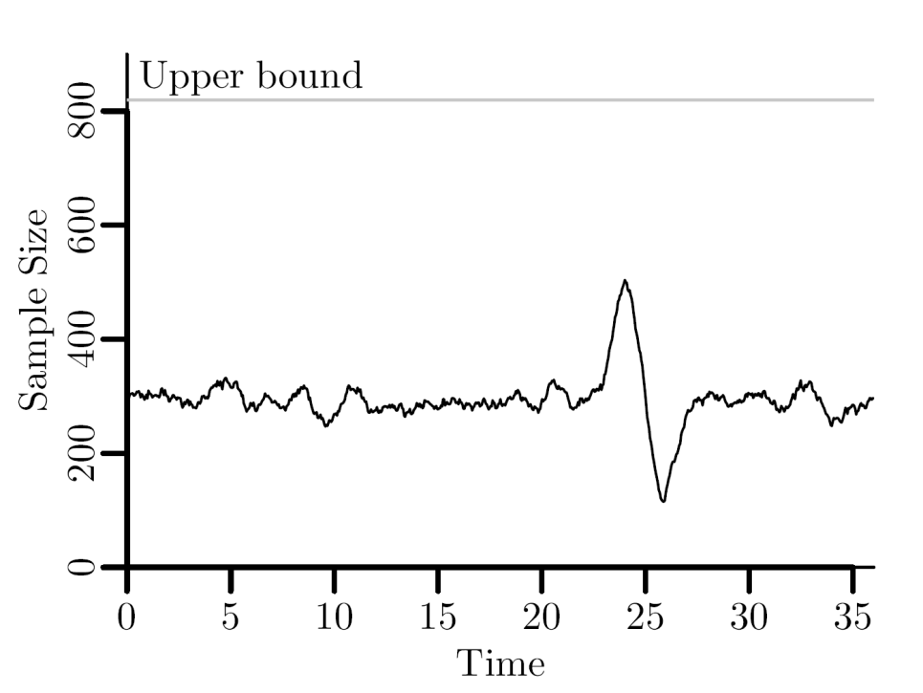
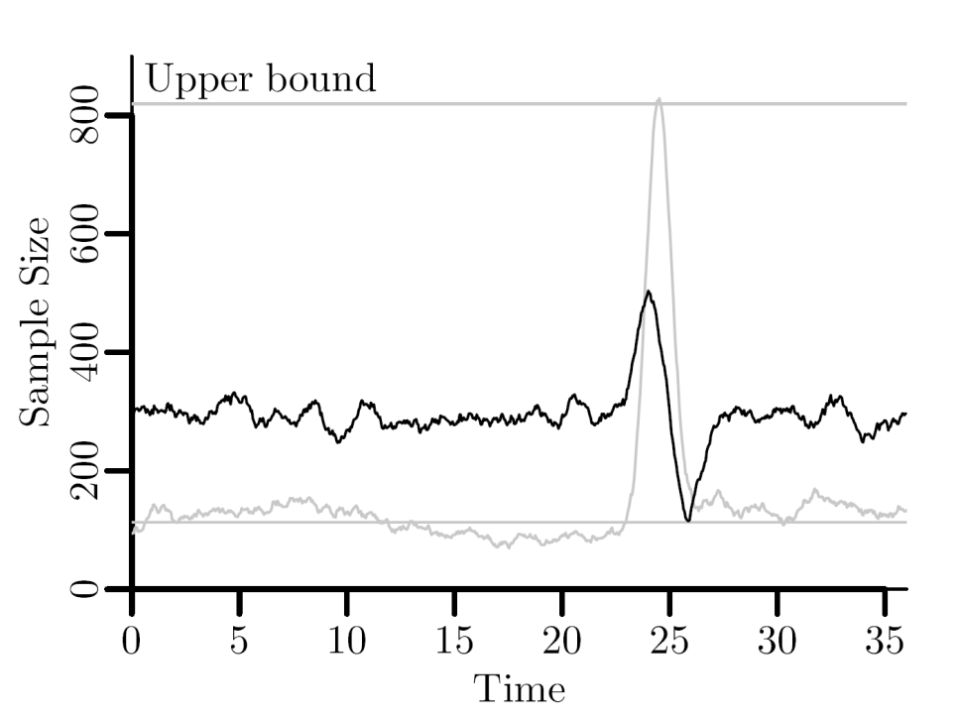
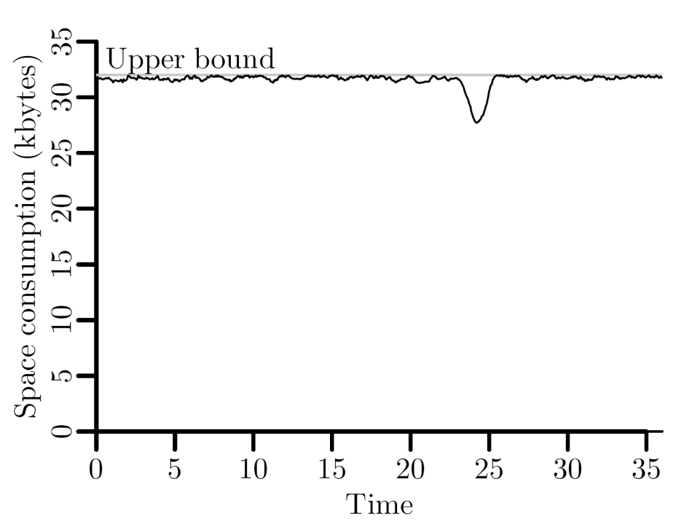
Example: Bounded Priority Sampling
Sample size
Sample space
k = 585 items

Slide 15
Sample Synopsis
  Sample size
  Fixed
  Bounded
  Unbounded
  Sample space
  Bounded
  Unbounded
Overhead
Sample
 | Size
 | Fixed | Bounded | Unbounded
Bounded | N/A | Bounded priority | N/A
Unbounded | Priority | ― | Bernoulli
Space

Slide 16
Outline
Introduction
Existing Techniques
Bounded Priority Sampling
Analysis & Experimental Results
Conclusion

Slide 17
Analysis of Sample Size
Setting
  e_{max}: highest priority item in current window (size N)
  e_{max}′: highest priority item in previous window (size N′)
Observation
  e_{max} is reported if its priority is higher than that of e_{max}′
Success probability (lower bound)
  P(|S|=1) = P(S={e_{max}})
  ≥ P(p_{max}>p_{max}′) = N/(N+N′)
Example
  N′=2, N=4
  ≥66%
Window size ratio
Notes:
Window size ratio

Slide 18
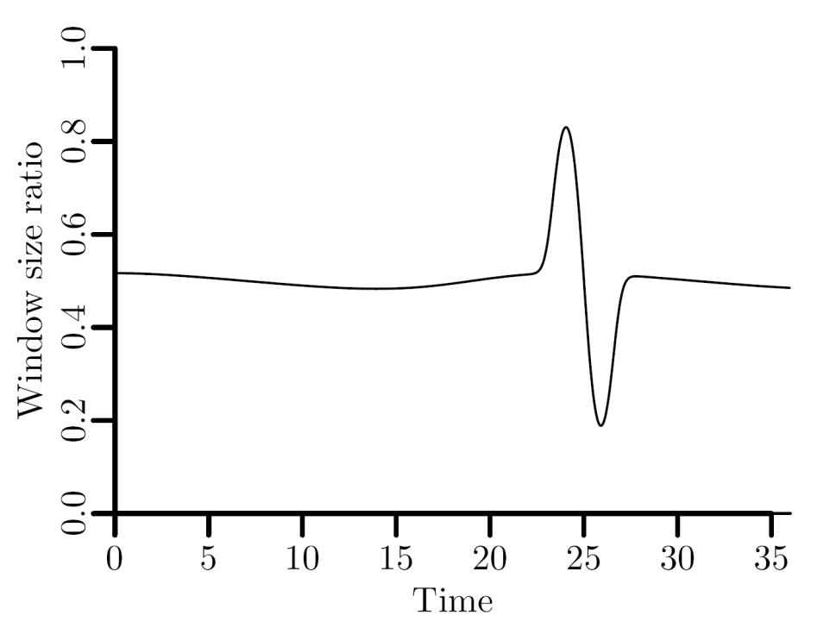
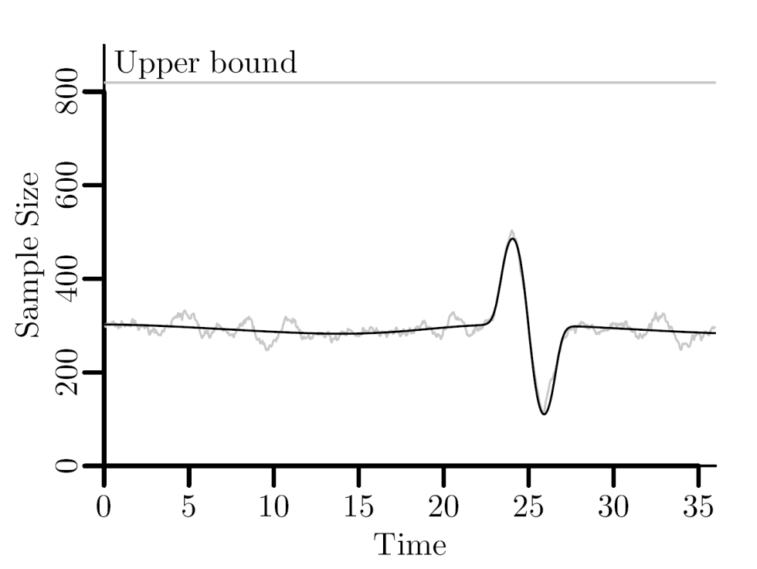
Example: Bounded Priority Sampling
Expected size

Slide 19
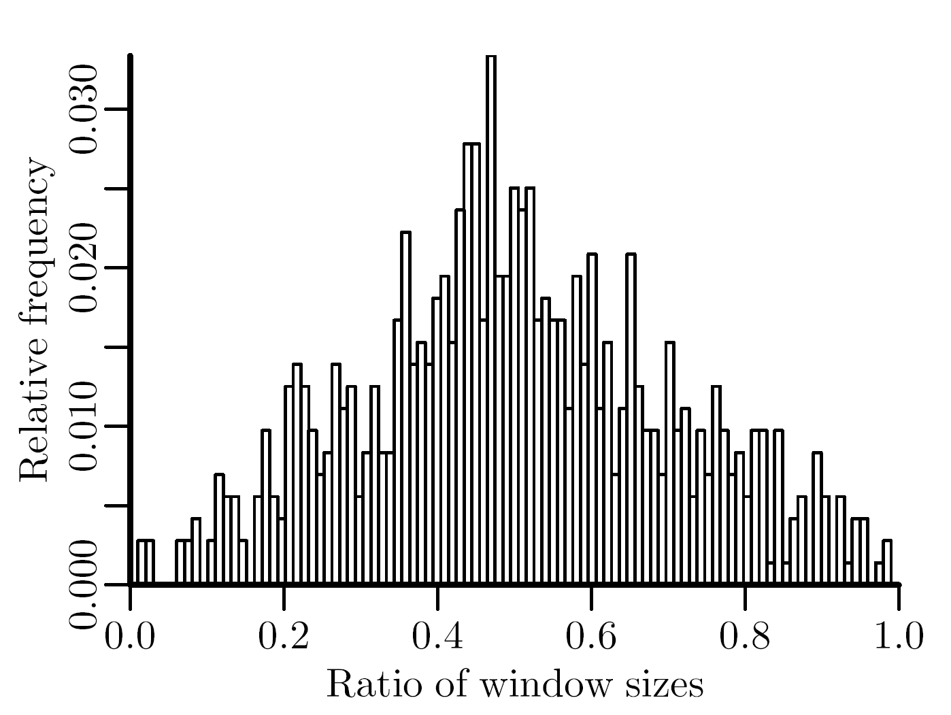
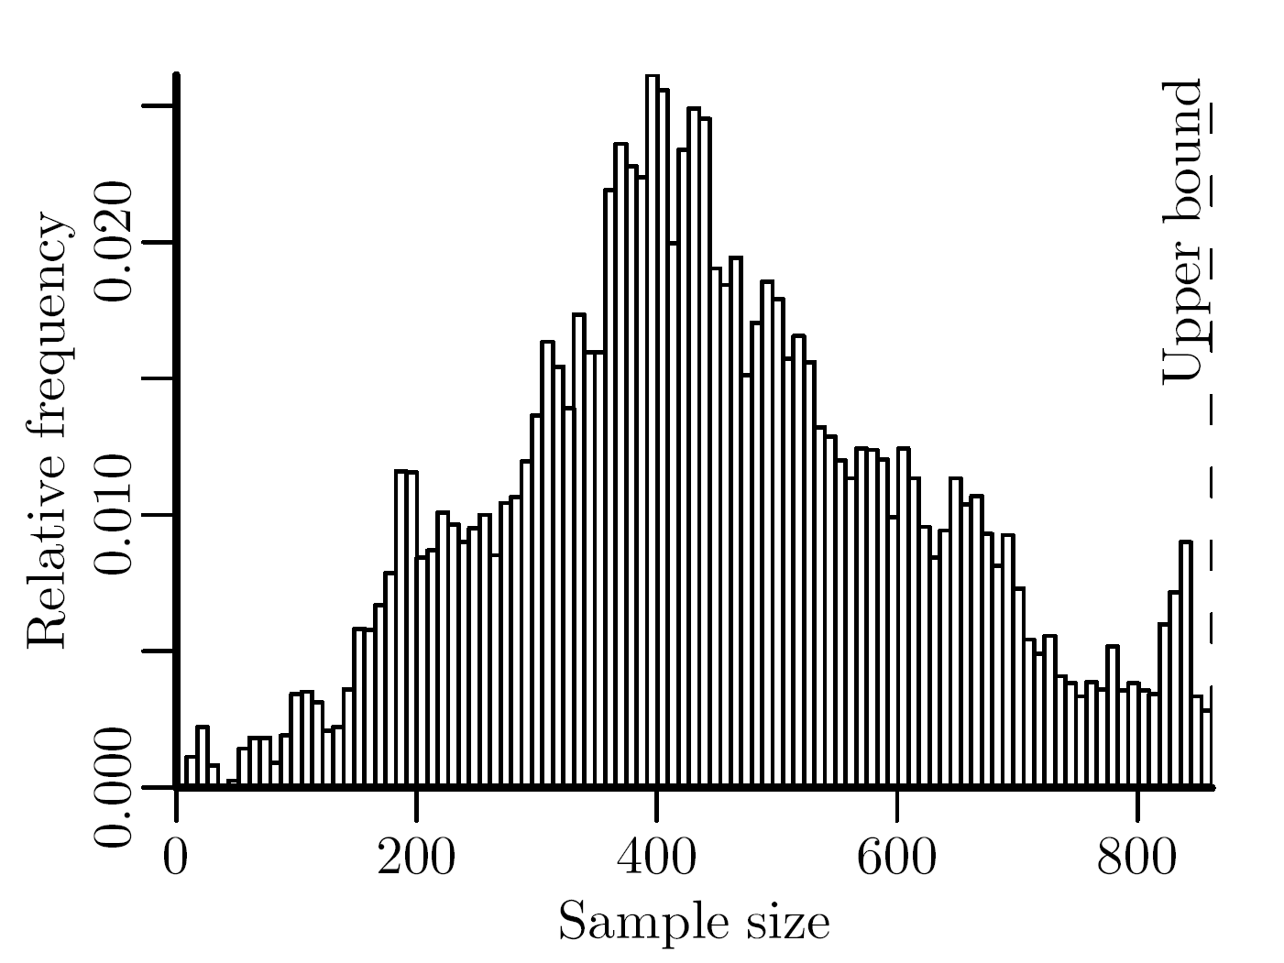
Experiments: Sample Size
NETWORK
  Network traffic data, bursty
  Min: 289 ― Avg: 11,724 ― Max: 1,180,077
  Items 22 byte → 32kbyte correspond to k = 862
Notes:
The NETWORK dataset has been collected by monitoring one of our web servers for a period of 1 month. The dataset contains 8, 430, 904 items, where each item represents a TCP packet and consists of a timestamp (8 bytes), a source IP and port (4 + 2 bytes), a destination IP and port (4 + 2 bytes) and the size of the user data (2 bytes).

Slide 20
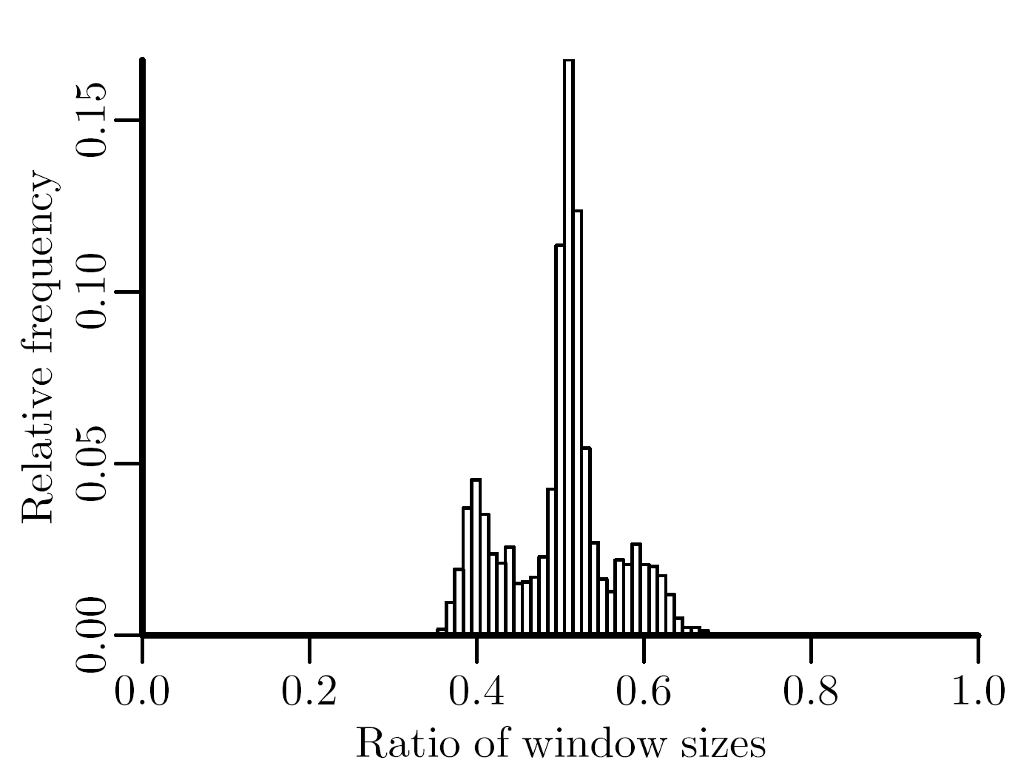
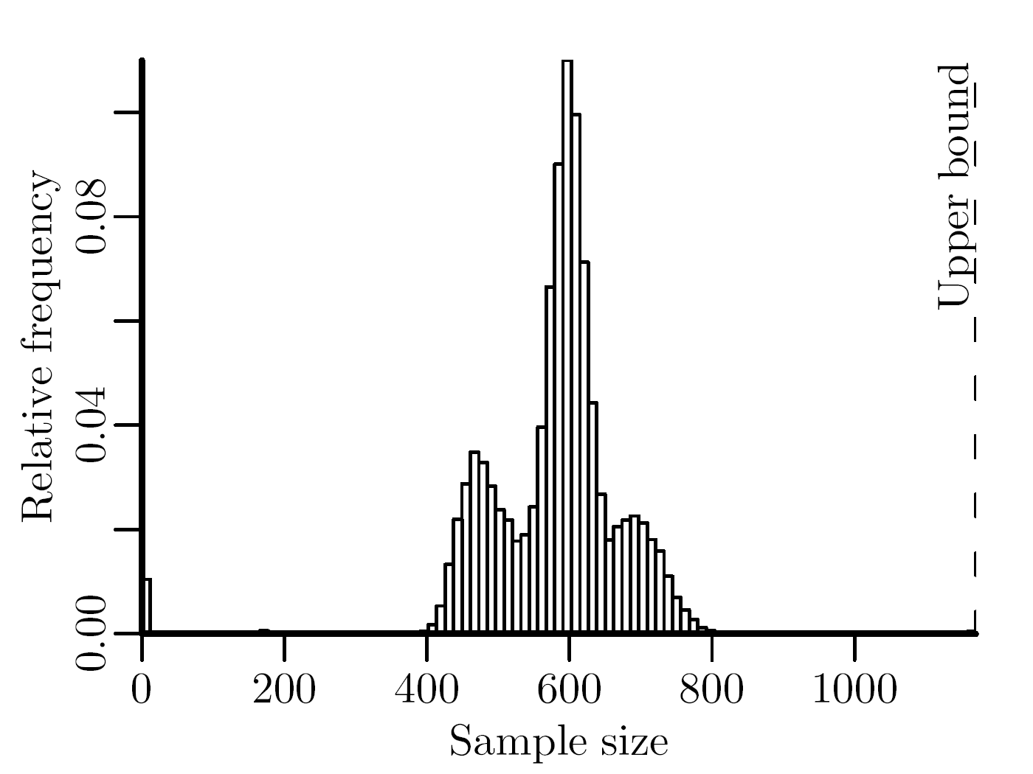
Experiments: Sample Size
SEARCH
  Usage statistics of search engine, slowly changing
  Min: 0 ― Avg: 16,482 ― Max: 37,947
  Items 12 bytes: 32kbyte correspond to k = 1,170
Notes:
The SEARCH dataset has been collected in a period of 3 months and contains 36, 389, 565 items. Each item consists of a timestamp (8 bytes) and a user id (4 bytes).

Slide 21
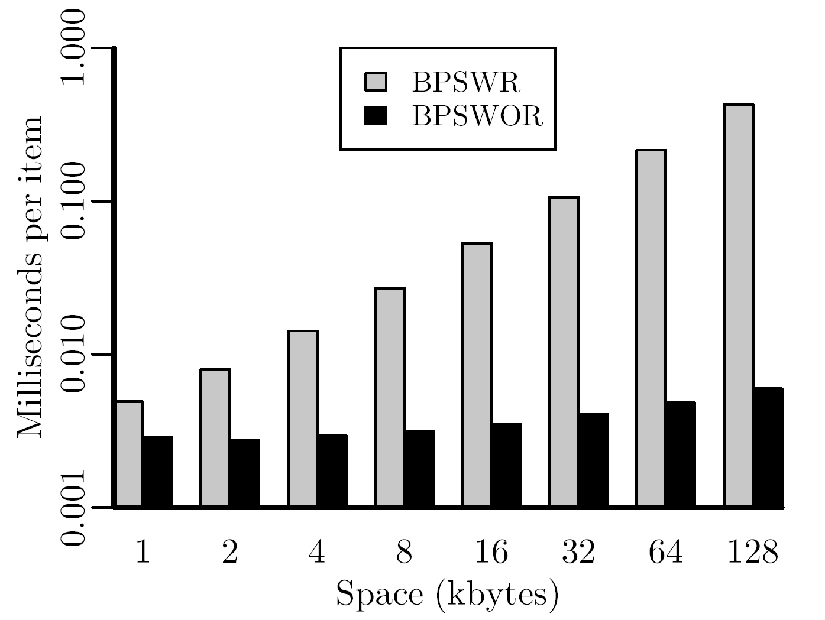
Sampling Multiple Items
Maintain k copies of the BPS data structure
  Slow: O(kN) time for window of size N
Maintain the k highest-priority items
  Fast: O(N + k logk logN) in expectation
NETWORK
Notes:
Treaps:
In-order timestamps
Heap-order priorities
Log N items in expectation accepted
klog k cost per accepted item

Slide 22
Outline
Introduction
Existing Techniques
Bounded Priority Sampling
Analysis & Experimental Results
Conclusion

Slide 23
Conclusion
Sampling time-based windows
  Challenging because window size fluctuates
  Existing schemes do not provide space guarantees
  Impossible to guarantee fixed sample size
Bounded priority sampling
  Proceed in a best-effort manner
  Probabilistic sample size guarantees
What else is in the paper?
  Estimation of window size
  Stratified sampling scheme

Slide 24
Thank you!
Questions?

Slide 25
Backup:
Stratified Sampling

Slide 26
Existing techniques
Stratified sampling
  Partition the stream into consecutive strata (partitions)
  Store stratum size, expiry timestamp and uniform sample
  When applicable, higher statistical efficiency possible
Equi-Width Stratification
  Start new stratum every Δt time units
N₁=2
N₂=1
N₃=6
N₄=0
50%
100%
16%
Notes:
Per-strata samples: insertion phase, deletion phase
(e.g. distinct value estimation, clustering)

Slide 27
Effect of stratum sizes
Example: Window Average
  Attribute is normally distributed, mean μ, variance σ²
  Estimator variance for per-strata samples of size n
  Minimized when all strata have the same size
Notes:
Mu_S = Horvitz-Thompson estimator

Slide 28
Solution
Optimum Stratification
  Strata have equal size
  Not possible because we cannot move boundaries arbitrary
  But: we can merge strata
Merge-Based Stratification
  Idea: Apply merges so as to minimize QS at time of expiration of first stratum
N₁=3
N₂=3
N₃=3
N₄=0
33%
33%
33%
Merge

Slide 29
Algorithm
Assumption (preliminary)
  Number N⁺ of arrivals till next stratum expiration known
Goal
  Partition the set
  into l-1 partitions so that sum of squares is minimized
  Dynamic programming
    Known algorithms: O(l(l+N⁺)²) time
    Here: O(l³) time
    Details in the paper
2,
1,
3,
1,1,1
N⁺=3

Slide 30
N⁺
Estimation
  Timespan till expiration of R₁: Δ
  Idea: estimate = number of arrivals in the last Δ time units
  Find j such that t-t_{j}>Δ and t-t_{j+1}≤Δ
  Estimate N⁺ as N_{j+1,l}/(t-t_{j})
Robustness
  Estimates may be wrong
  But we observe wrong estimates
  Algorithm
    Estimate N⁺ and expected time of next merge
    If N⁺ items arrive before that time: recompute
    If N⁺ items arrive around that time: merge
    If less then N⁺ items have arrived: recompute
Notes:
t is now.
The tj‘s are the expiration times of the strata
Expected time is calculated by assuming that the N+ items arrive with a constant arrival rate
5% threshold aroud expected time to avoid overly frequent recomputation

Slide 31
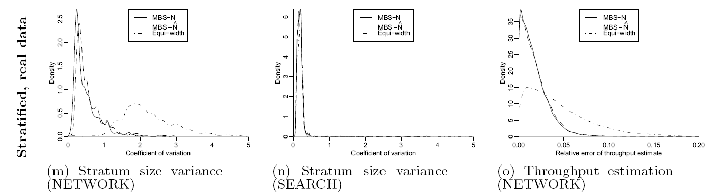
Stratified sampling
Results
Notes:
MBS-N is hypothetical scheme which does not need to estimate N+ but knows it exactly
MBS-N^ is the robust scheme of this paper

Slide 32
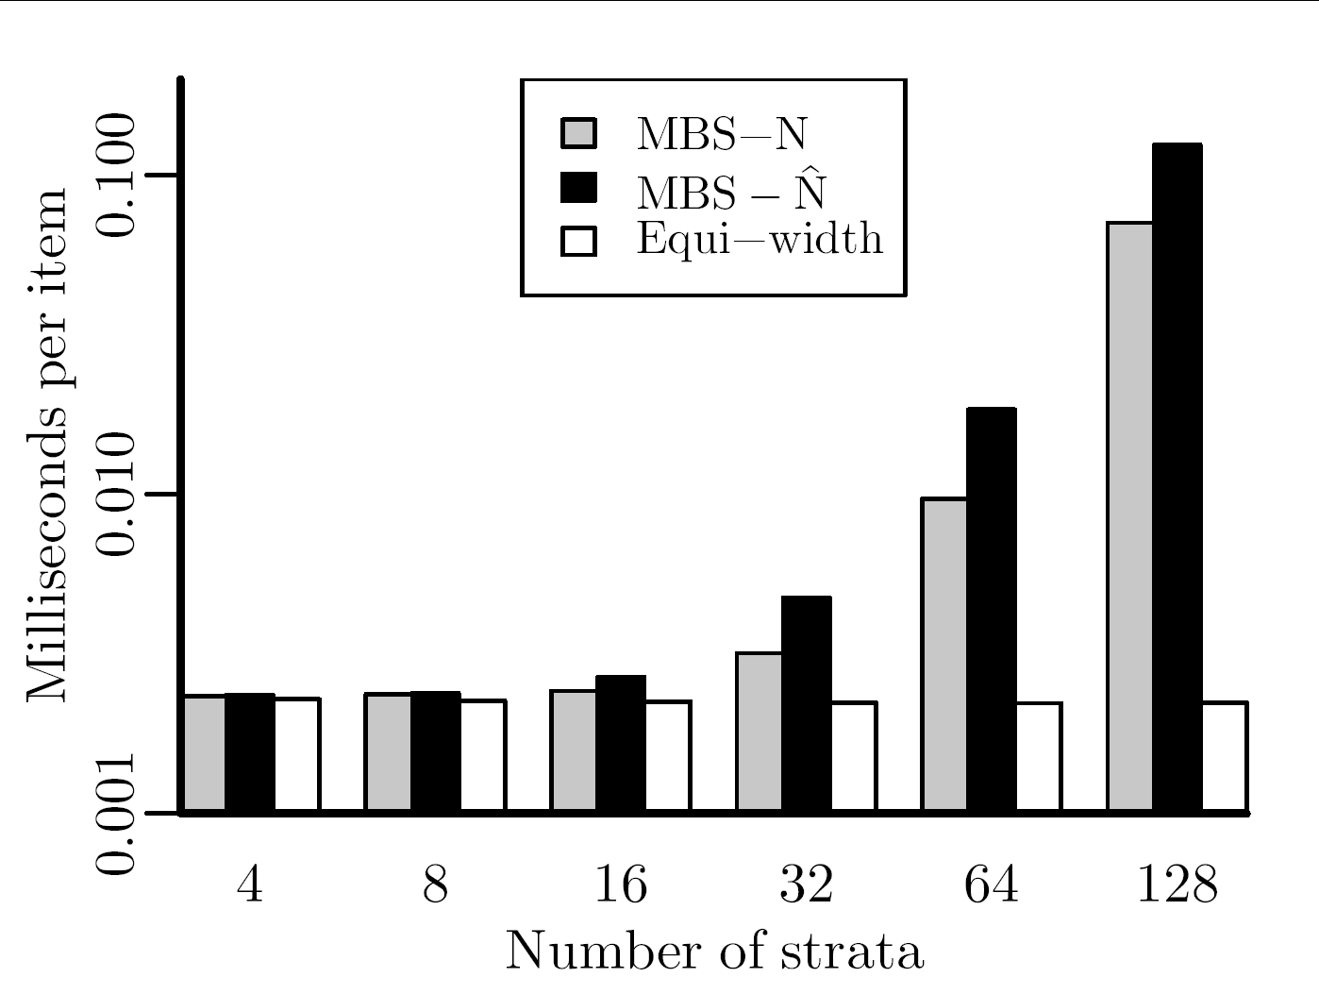
Stratified sampling
Time per item

Slide 33
Backup:
Sampling Multiple Items

Slide 34
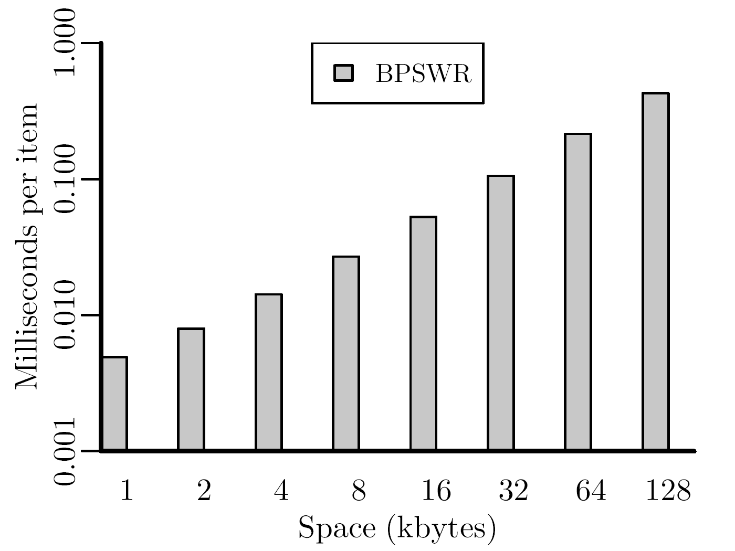
Sampling Multiple Items
So far: With replacement
  Maintain k copies of the BPS data structure
  k priorities per item
  Slow: O(kN) time for window of size N
NETWORK

Slide 35
Sampling Multiple Items
Without replacement
  maintain the k highest-priority items
    k candidates,
    k test items
  1 priority per item
Sample extraction
  Generalization for single item case
  Report: top-k (S_{cand} ∪ S_{test}) ∩ S_{cand}
∪
top-k
∩

Slide 36
Sampling Multiple Items
Cost
  Naive: O(kN) time as well
  With treaps: expected O(N + k logk logN)
NETWORK
Notes:
Treaps:
In-order timestamps
Heap-order priorities
Log N items in expectation accepted
klog k cost per accepted item

Slide 37
Backup:
Older slides

Slide 38
Data streams
Data stream
  High speed
  Processed on the fly
  Recent items more important
Statistics of interest
  Arrival rates
  Selectivities
  Quantiles
  Heavy hitters
  Subset sums
  Distinct counts
  Clustering
  For a recent time interval
  (e.g., 4 hours)

Slide 39
Sampling data streams
Approximation
  Required to cope with (worst-case) load
  Many specialized techniques exist
Random sampling
  Approach: Maintain a sample of the recent items
  Less accurate but versatile
Problem
  Given a memory budget, maintain a sample of the items that arrived in a recent time interval
Notes:
Sampling can be used to estimate any of the forementioned statistics
Especially useful for ad hoc-querying

Slide 40
Sampling from sliding windows
Method 1: Sequence-based sampling
  Sample from window of fixed size, then select recent items
Method 2: Time-based sampling
  Sample directly from window of fixed width
Outdated
Not representative
How to maintain?
Notes:
Fixed size → varying widht
Fixed width → varying size

