Slide 1
Sampling Algorithms for Evolving Datasets Rainer Gemulla Defense of Ph.D. Thesis 20.10.2008
Faculty of Computer Science, Institute of System Architecture, Database Technology Group

Slide 2
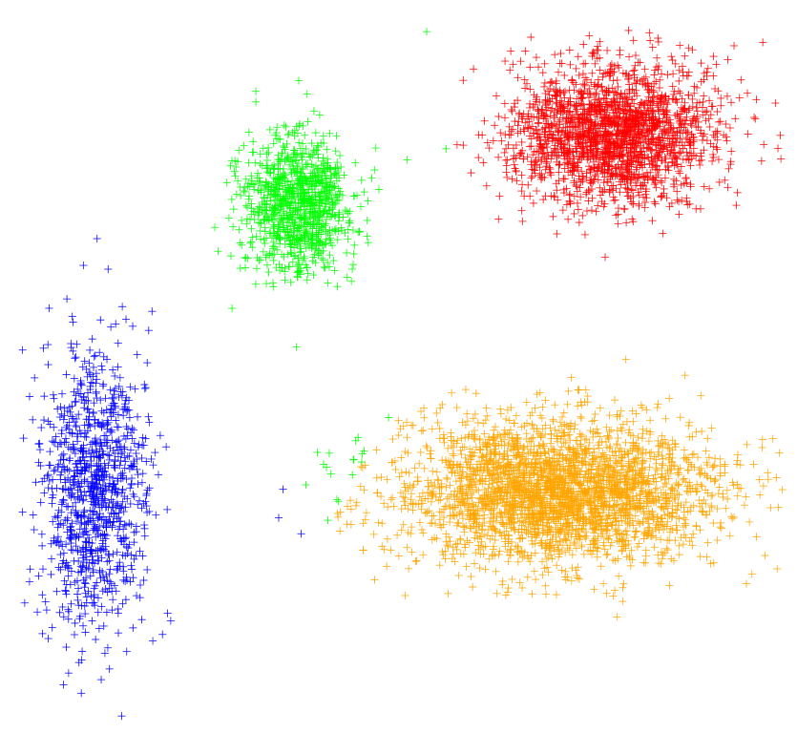
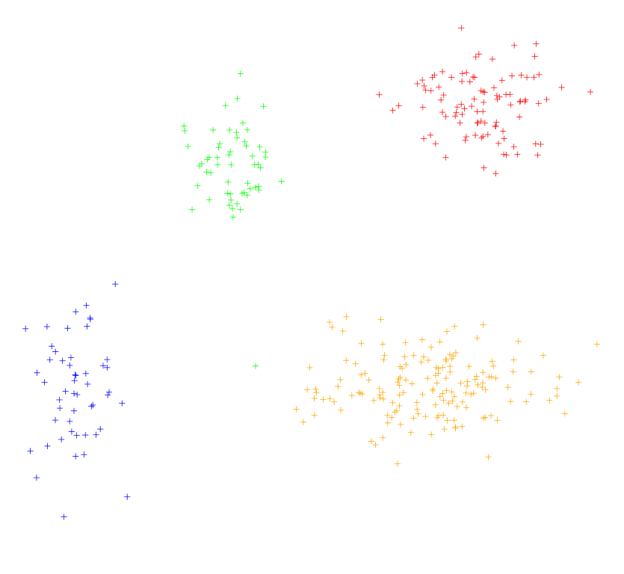
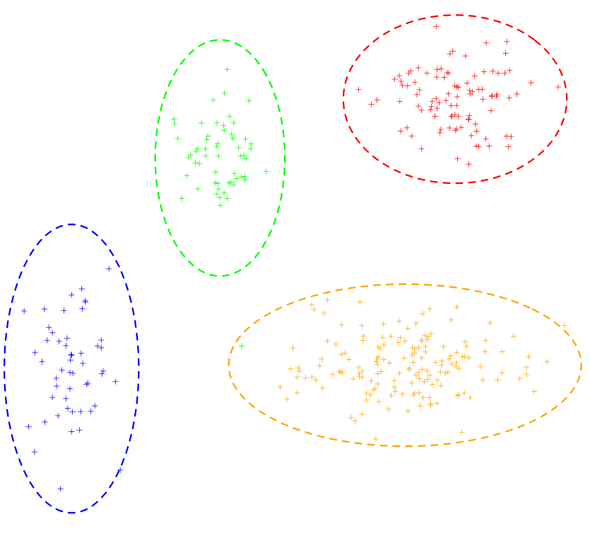
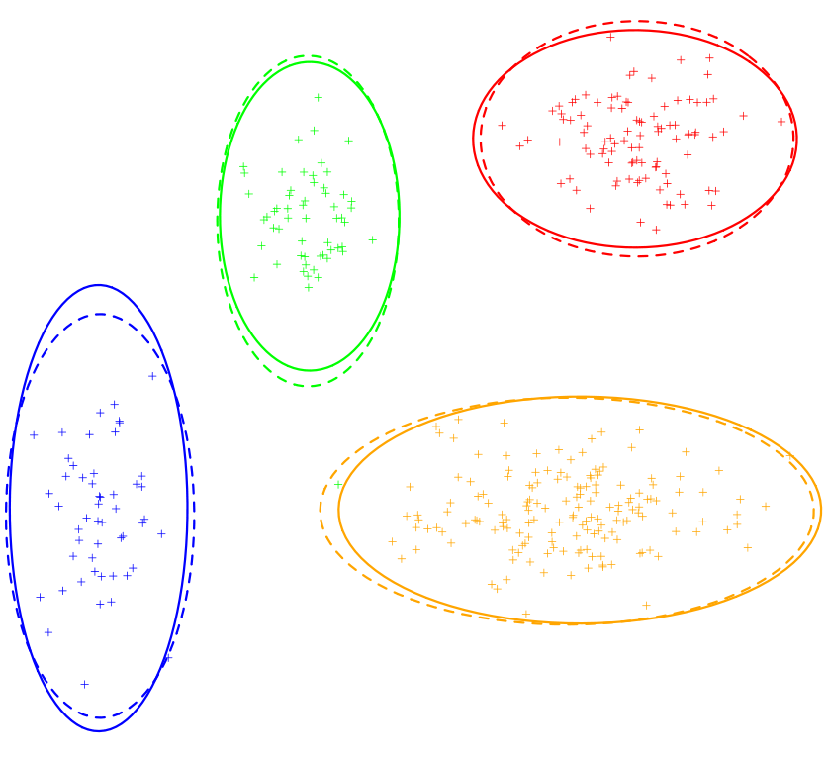
Application Level (external)
Clustering
Find similar groups
Ofter superlinear in input size
Procedure
Run k-means
Estimate mean and variance
99% confidence interval under normal distribution
Run on sample
5%
Notes:
Approximate query answering
Data mining
Data integration

Slide 3
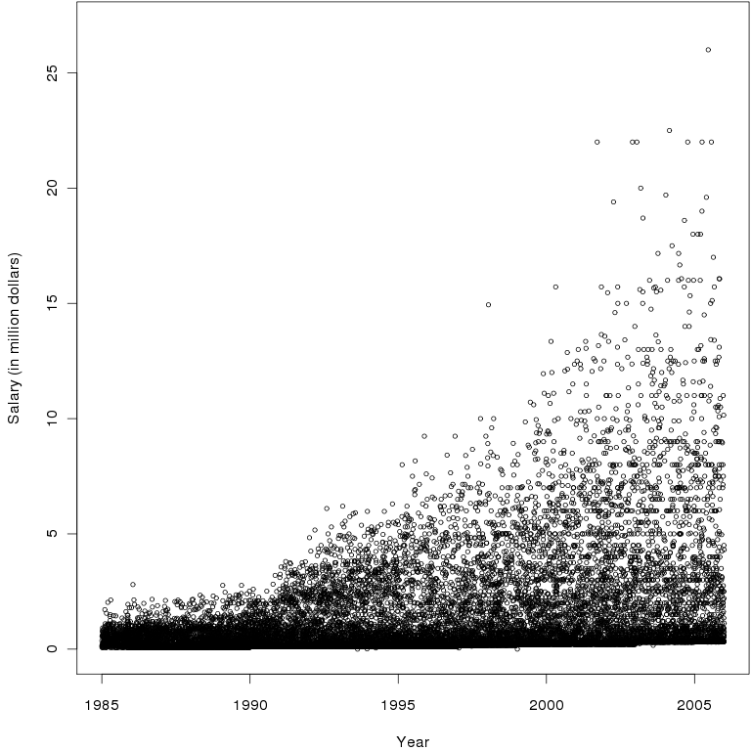
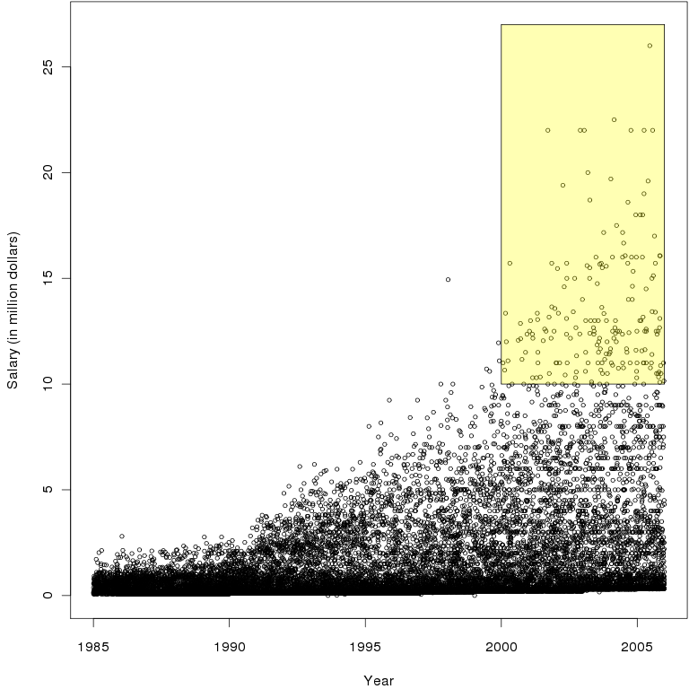
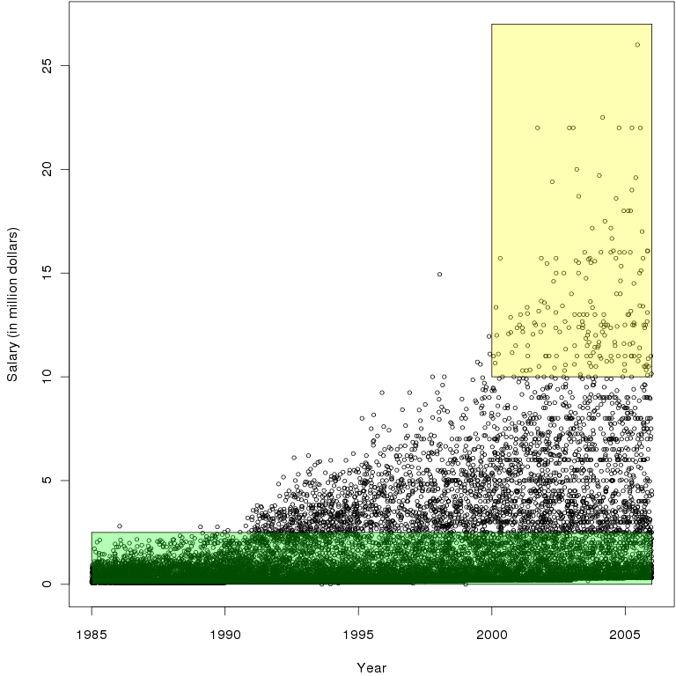
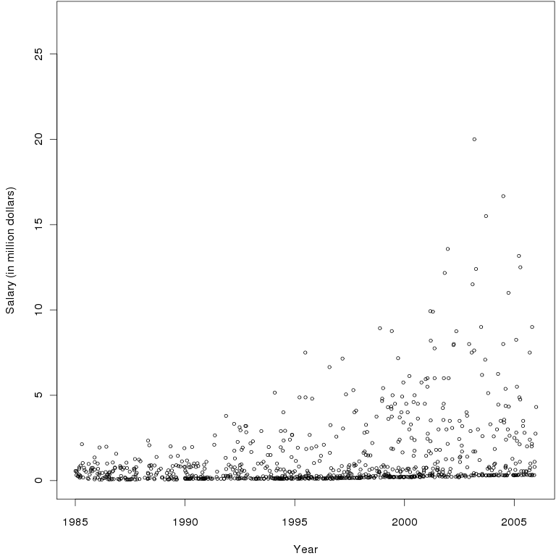
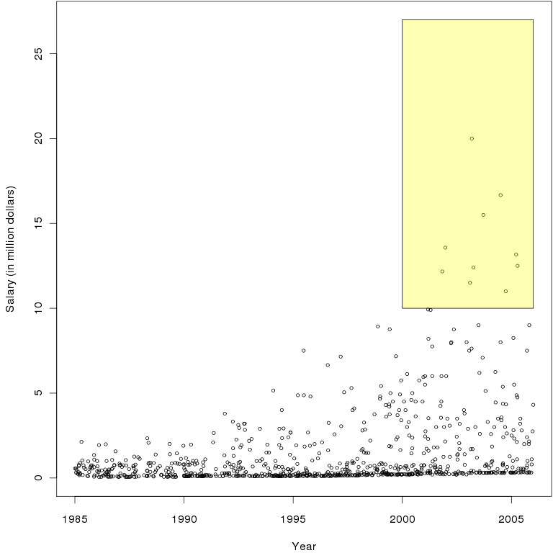
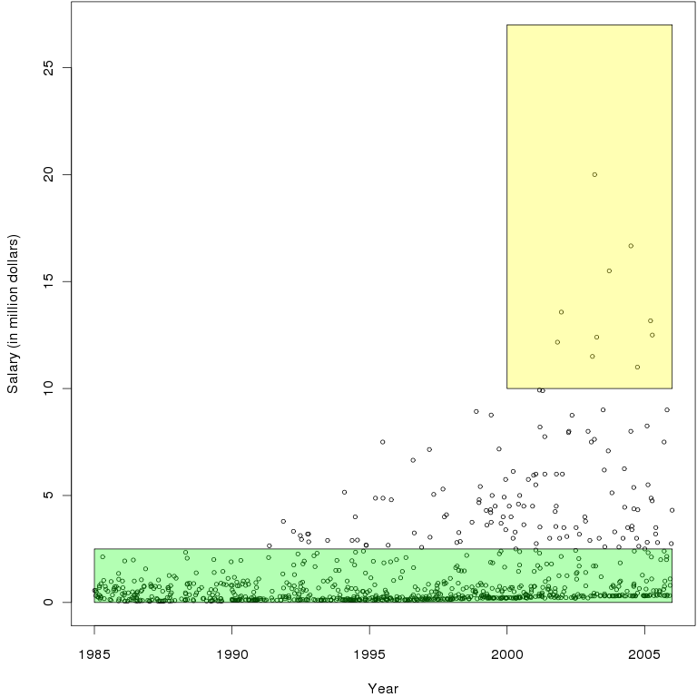
System Level (internal)
Selectivity Estimation
Determine percent- age of tuples that satisfy a query
Key to effective query optimization
Procedure
Exact computation
5% Sample
How good is this?
Arbitrary dataset
1% absolute error, 95% confidence
≈20k items
Exact:
1.1%
Sample:
≈1.2%
Sample:
≈83,6%
Exact:
83,8%
Notes:
Query optimization
Parameterization of algorithms
Load balancing
Number of rows has a binomial distribution Pr[X=k]=(n k) f^k (1-f)^k
Pr[error > 1%] = Pr[|f-X/n|> 1%]
1/(2*epsilon^2) ln(2/failure_prob)=18445

Slide 4
Applications
Sample Computation
Sample Maintenance
The Whole Picture
Conclusion

Slide 5
Option 1: Query Sampling
Base data
Sampling
step
Approximate
queries
Queries
Updates
Estimation
step
Approximate
results
Advantages
No impact on traditional query processing
No storage requirements
Disadvantages
Sampling step is expensive
Supports only simple queries
Cannot handle data skew
Notes:
evreads <- function(q, b) 1-(1-q)^b
10000 blocks a 100 tuples per block

Slide 6
Option 2: Materialized Sampling
Base data
Queries
Sample
data
Approximate
queries
Estimation
step
Approximate
results
Updates
Sampling
step
My thesis
Advantages
Quick access to the sample
Sophisticated preprocessing feasible
Disadvantages
Storage space
Impact on updates

Slide 7
Applications
Sample Computation
Sample Maintenance
The Whole Picture
Conclusion

Slide 8
Sample Maintenance
Maintenance Problem for Evolving Datasets
Given: a dataset, a sample, a stream of operations
Insert: Add an item to the dataset
Update: Change the value of an item in the dataset
Delete: Remove an item from the dataset
Goal: maintain the statistical validity of the sample
Uniform Sampling
Each two samples of the same size are equally likely
Example dataset: {A, B, C}
Size 0 | Size 1 | Size 2 | Size 3
∅ | {A} | {A, B} | {A, B, C}
 | {B} | {A, C}
 | {C} | {B, C}
Size 0 | Size 1 | Size 2 | Size 3
∅ | {A} | {A, B} 33% | {A, B, C}
 | {B} | {A, C} 33%
 | {C} | {B, C} 33%
Size 0 | Size 1 | Size 2 | Size 3
∅ | {A} 13% | {A, B} 20% | {A, B, C}
 | {B} 13% | {A, C} 20%
 | {C} 13% | {B, C} 20%
Size 0 | Size 1 | Size 2 | Size 3
∅ | {A} 20% | {A, B} | {A, B, C}
 | {B} 20% | {A, C}
 | {C} 60% | {B, C} | NOT UNIFORM

Slide 9
The Classic Schemes
Reservoir sampling
Computes a random sample of size M
Fixed space consumption & response time
Might produce undersized samples
Bernoulli sampling
Computes a random sample of fraction ≈q
Varying space consumption & response time
Might produce oversized samples
Problems
Support for updates & deletions
Support for multisets & projections of multisets
Support for resizing & combination
Schemes cannot be used directly!
M=800k
q=10%

Slide 10
Reservoir Sampling & Deletions
Key problem
Deletions decrease the sample size
Proposed solutions
CAR samples, backing samples, tagged samples, passive samples, purged bernoulli samples, …
Key ideas
Refill: go to the base data and get replacement
Recompute: let the sample shrink, but recompute occasionally
{A, B, C}
A
B
A
C
B
C
33%
33%
33%
-C
A
B
A
B

Slide 11
Sample Size & Cost
=2% of the data
Almost constant
sample size
Zero base data accesses

Slide 12
Random Pairing
How does it work?
Compensates deletions with subsequent insertions
Details
Pair each insertion with a deleted „partner“
Undo the deletion of the partner
{A, B, C}
A
B
A
C
B
C
33%
33%
33%
1
1
1
Direct pairing would require entire deletion history
→ Use a randomized pairing
-C
A
B
A
B
33%
33%
33%
Pair!
1
1
Pair!
1
A
A
B
B
A
A
C
D
B
B
C
+C
D
+D
33%
33%
33%

Slide 13
Bernoulli Sampling & Multisets
Why multisets?
Only columns relevant for analysis are stored in the sample
May not include the primary key
Bernoulli sampling on multisets
Insertions
Accept with probability q, reject otherwise
Deletions
Pick a random copy and undo its insertion
Sample size is reduced when picked copy was sampled
Occurs with probability #sample/#base
We know #sample but not #base
A
A
A
A
A
A
A
A
A
A
S={(A,4)}
S=∅
S={(A,1)}
S={(A,2)}
S={(A,3)}

Slide 14
Augmented Bernoulli Sampling
Augmenting the sample
Count the number of insertions since first acceptance
How does this help to process deletions?
Delete right-side items first
We know the total number of A‘s
Naive scheme with probability (#sample-1)/(#inserts-1)
When empty, delete left-side item
A
A
A
A
A
A
A
A
A
A
A
S=∅
S={(A,1,1)}
S={(A,2,2)}
S={(A,2,3)}
S={(A,4,6)}
S={(A,3,5)}
S={(A,3,4)}
#sample
#inserts
=#right+1
Left
Just one sample
Right
Full knowledge

Slide 15
Applications
Sample Computation
Sample Maintenance
The Whole Picture
Conclusion

Slide 16
Incremental Sample Maintenance
Different scenarios require different sampling schemes
Base data
Set
Multiset
Projection
(distinct items)
Data stream window
Fixed
Fraction
Size
Fraction
Size
Fraction
Size
Fraction
Size
Insert
Update
?
n/a
n/a
Delete
?
n/a
n/a
Survey sampling
Previous work
Novel schemes

Slide 17
Applications
Sample Computation
Sample Maintenance
The Whole Picture
Conclusion

Slide 18
Conclusion
Database sampling
Has a lot of applications …
… and provides us with a lot of interesting problems
Materialized sampling
Avoids performance problems of query sampling
Requires maintenance as data evolves
Efficient, incremental maintenance algorithms exist
In the thesis
Novel sampling algorithms
Improved estimators
Algorithms for resizing samples
Algorithms for combining samples
Notes:
Query sampling: slow, complex queries, data skew

Slide 19
Thank you!
Questions?

Slide 20
Survey Sampling
 | Survey Sampling | Database Sampling
Applications | Opinion polls, market research, social sciences, … | Query optimization, approximate query processing, data mining, …
Purpose | Known a priori | Often unknown a priori
Access to full data | Impossible | Infeasible
Domain expertise | Available | Unavailable
Sampling designs | Sophisticated | Simple
Sample size | Small | Large
Datasets | Evolving | Evolving
Access to changes | No | Yes
Precomputation | Impossible | Possible
Notes:
Full data:
- Not accessible: non-response, measurement errors, huge amount of human resources required

Slide 21
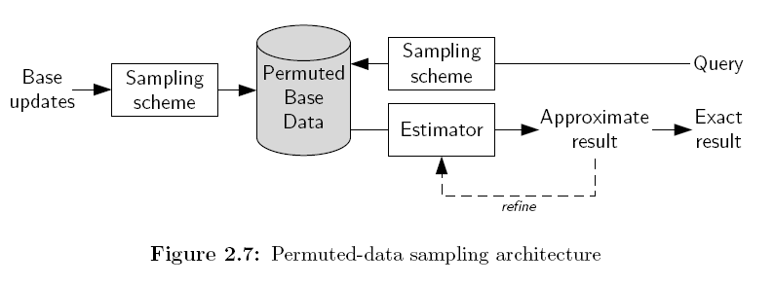
Permuted-Data Sampling

Slide 22
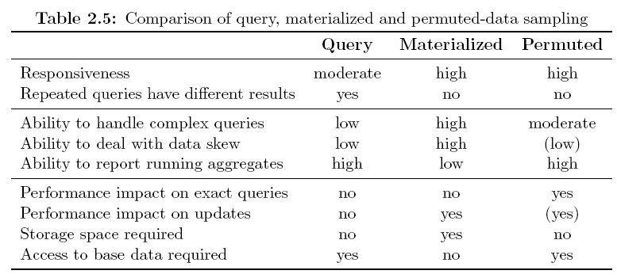
Rough Comparison

Slide 23
Reservoir Sampling
Reservoir sampling
computes a uniform sample of M elements
building block for many sophisticated sampling schemes
single-scan algorithm
add the first M elements
afterwards, flip a coin
ignore the element (reject)
replace a random element in the sample (accept)
accept probability of the ith element
Notes:
can be used to maintain a sample (insertions only)

Slide 24
Reservoir Sampling (Example)
Example
sample size M = 2

Slide 25
Backup: An Incorrect Approach
Idea
use arriving insertions to refill the sample
Not uniform!

Slide 26
Random Pairing
Example

Slide 27
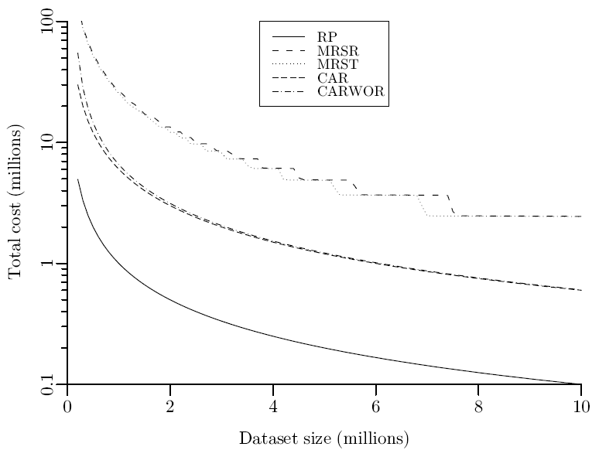
Total Cost
Total cost
stable dataset, 10M operations
sample size 100k, data access 10 times more expensive than sample access
Base data access
No base data access
Notes:
we counted number of accesses to sample & bast data
logarithmic scale!
# (Test 10) Sigmod06Evaluation.evaluatePerformanceSize()
#
# targetSize = 100000
# noOperations = 10000000
# db sizes = 5000000 5100000 5200000 5300000 5400000 5500000 5600000 5700000 5800000 5900000 6000000 6100000 6200000 6300000 6400000 6500000 6600000 6700000 6800000 6900000 7000000 7100000 7200000 7300000 7400000 7500000 7600000 7700000 7800000 7900000 8000000 8100000 8200000 8300000 8400000 8500000 8600000 8700000 8800000 8900000 9000000 9100000 9500000 9300000 9400000 9500000 9600000 9700000 9800000 9900000 10000000
# repetitions = 1000
# minSize = 80000
# qratio = 0.8

Slide 28
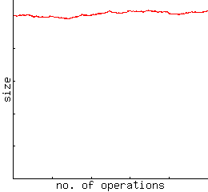
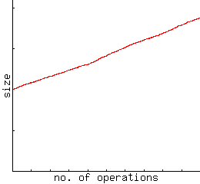
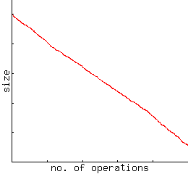
Types of Data Sets
Data sets
variation of data set size
influence on sampling
Stable
Growing
Shrinking
Goal:
stable sample
Goal:
controlled growing sample
uninteresting
Notes:
initial size 1M
random decision between 30 inserts/deletions

Slide 29
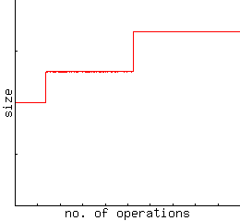
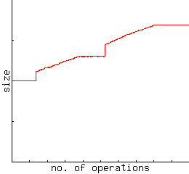
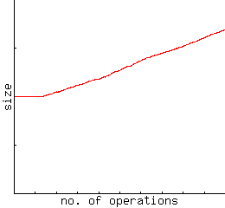
Resizing
Example
resize by 30% if sampling fraction drops below 9%
dependent on costs of accessing base data
Low costs
Moderate costs
High costs
immediate resizing
combined solution
Random pairing resizing
Notes:
there is no space to print the data set
same experimental settings as in the other schemes

Slide 30
Backup: Bounded-Size Sampling
Why sampling?
performance, performance, performance
How much to sample?
influencing factors
storage consumption
response time
accuracy
choosing the sample size / sampling fraction
largest sample that meets storage requirements
largest sample that meets response time requirements
smallest sample that meets accuracy requirements

Slide 31
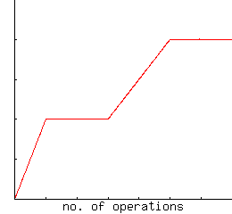
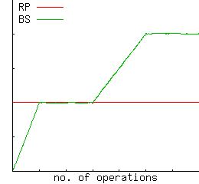
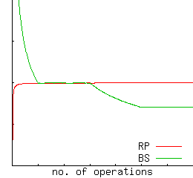
Backup: Bounded-Size Sampling
Example
random pairing vs. bernoulli sampling
average estimation
Data set
Sample size
Standard error
BS violates 1, 2
BS violates 3
Notes:
# (Test 12) Vldb06Evaluation.evaluateBernoulli()
#
# DATASET_SIZE1 = 1000000
# DATASET_SIZE2 = 2000000
# RUNS1 = 2000000
# RUNS1_2 = 2000000
# RUNS2 = 2000000
# SAMPLING_FRACTION = 0.01
# SAMPLE_SIZE = 10000
# PRINT_RATE = 10000

Slide 32
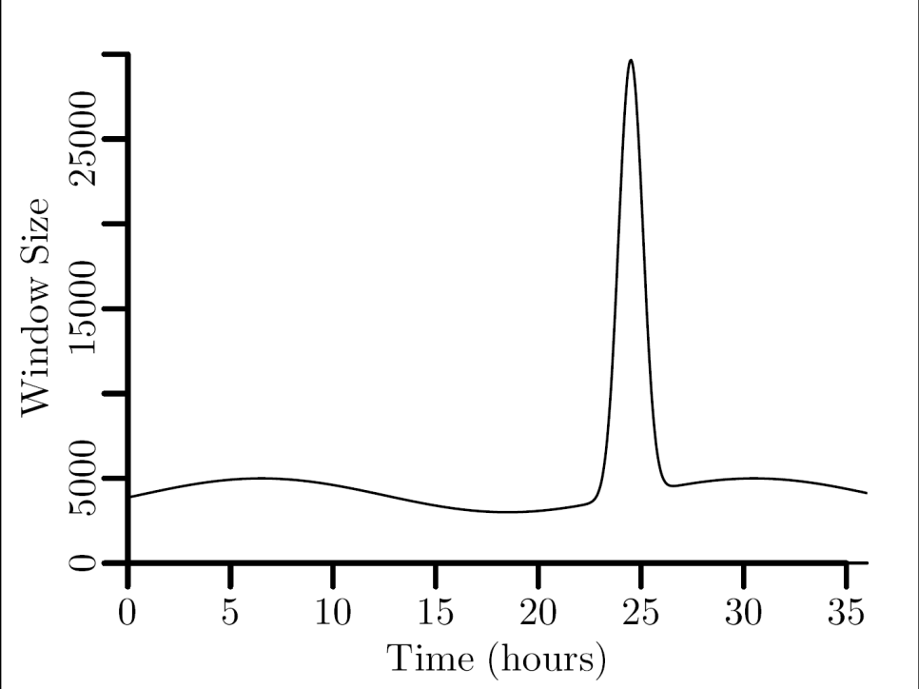
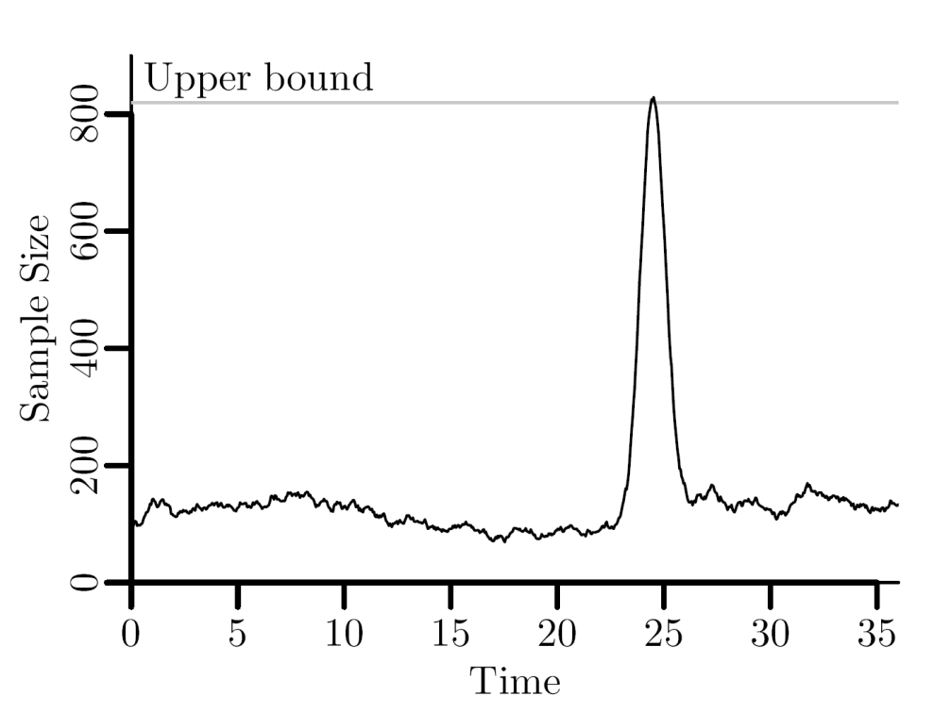
Example: Bernoulli sampling
Bernoulli sampling (coin-flip sample)
each item is included with probability q (=sampling rate)
sample size is qN in expectation, where N is window size
not a bounded-space scheme
Example: 40byte items, 32kbyte space → max 819 items
q = 0.0276

Slide 33
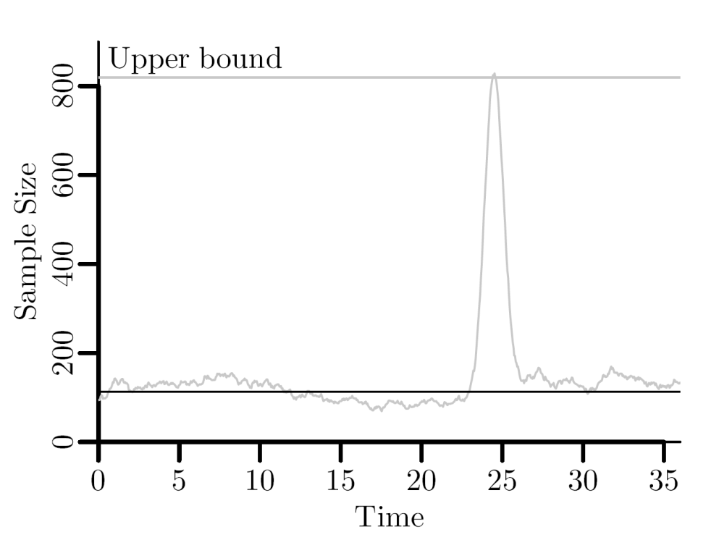
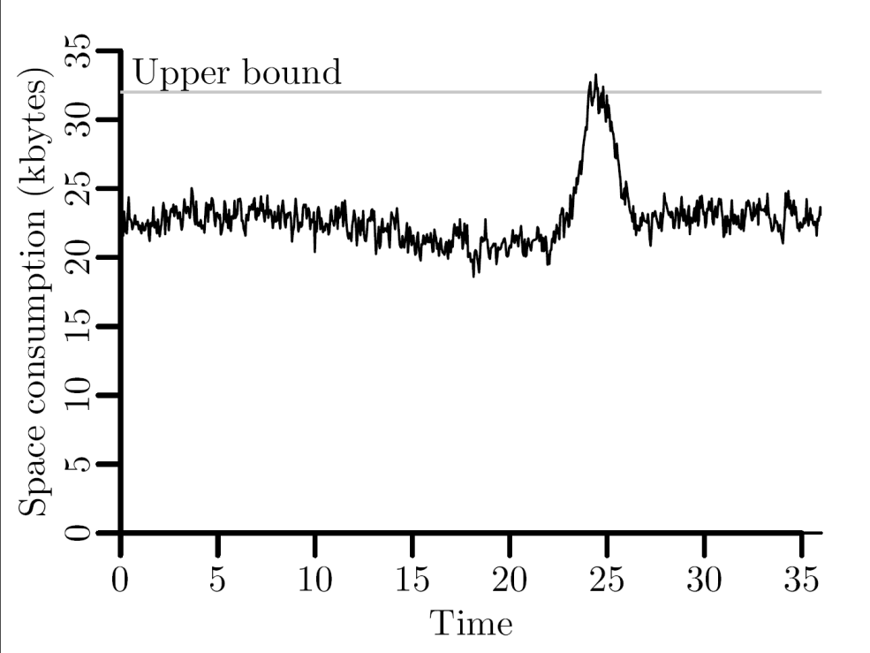
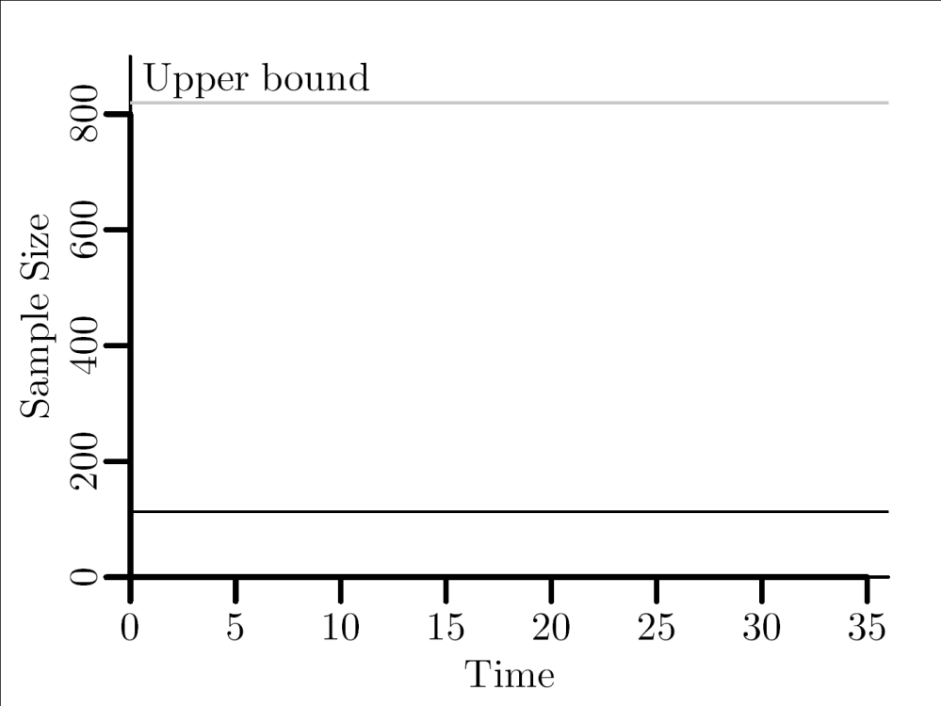
Example: Priority Sampling
Sample size
Sample space
k = 113 items

Slide 34
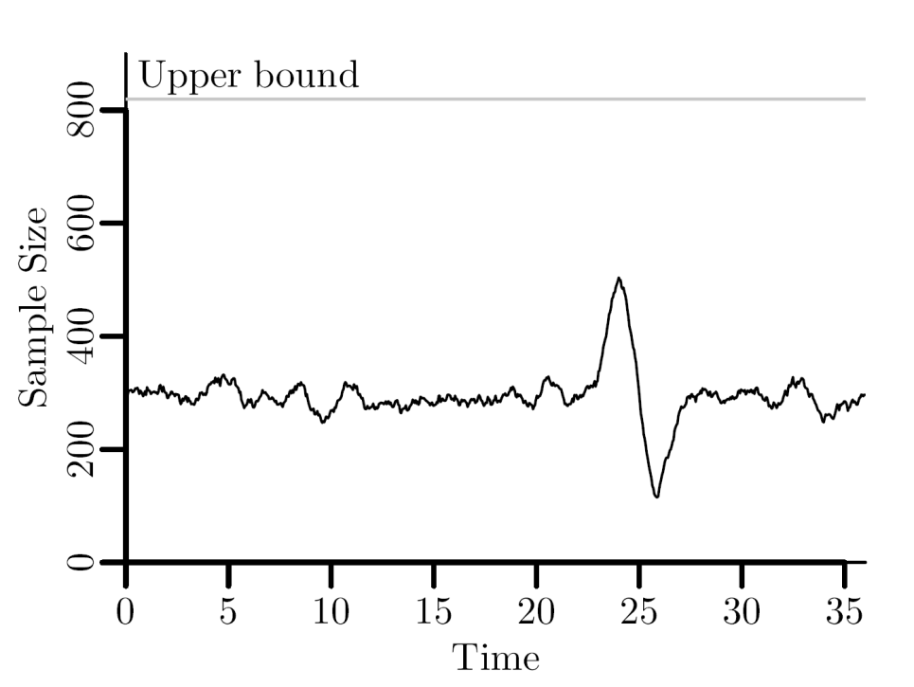
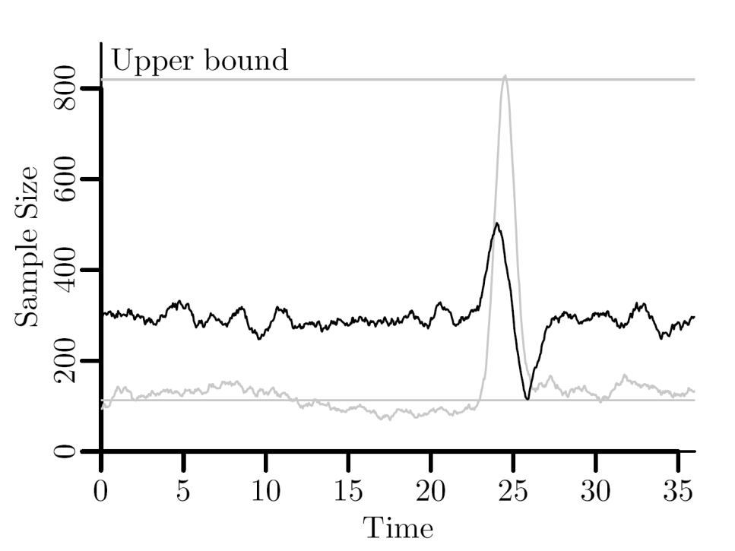
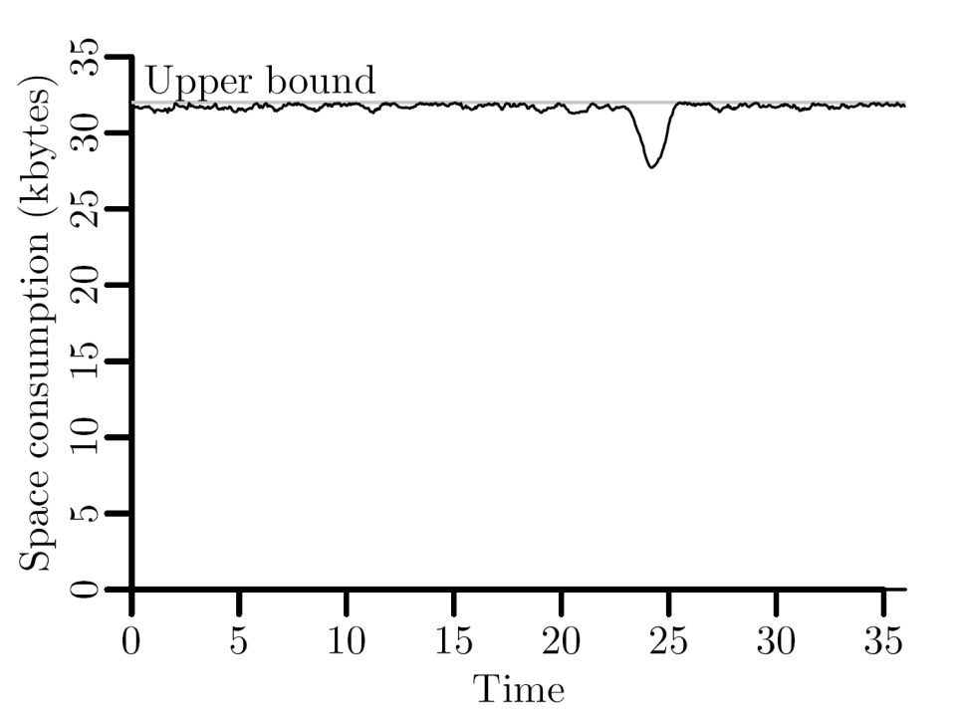
Example: Bounded Priority Sampling
Sample size
Sample space
k = 585 items

Slide 35
More Motivation: A Sample Warehouse
Full-Scale
Warehouse Of
Data Partitions
Sample
Sample
Sample
Warehouse
of Samples
S_{1,1}
S_{1,2}
S_{n,m}
merge
S*,*
S_{1-2,3-7}
etc

