Slide 1
k-Ary Search on Modern Processors
Fakultät Informatik, Institut Systemarchitektur, Professur Datenbanken
Sigmod/DaMon 2009
Benjamin Schlegel, Rainer Gemulla, Wolfgang Lehner

Slide 2
Motivation
Searching
Is a fundamental operation in computer science
Many application areas (e.g. databases, …)
Demand for high performance
Different Types of Searching
Point queries
Nearest-neighbor key queries
Range queries

Slide 3
Motivation - Search algorithms
Linear search
Linear complexity
Useful for small datasets
Hash-based search
Constant (best) complexity
Additional space requirements
Bad performance for range/nearest-key queries
Tree-based search
Logarithmic complexity
Good update properties
Sort-based search
Logarithmic complexity
No additional space requirements
Cache-conscious range scans
h(x)

Slide 4
Agenda
Motivation
Prerequisites
Binary search
SIMDized Binary Search
k-Ary Search
Sorted Array
Linearized k-ary Search Tree
Experiments
Conclusion

Slide 5
Binary search on a sorted array
Idea
Divide the search space in each iteration into two partitions
Reduce the search space to one of the partitions
Example
Successful search for key 4
Analysis
Worst-case iterations = ⎡log₂(N+1)⎤
Problems
No usage of modern CPU instruction sets
1
1
1
1
1
1
4
4
4
4
4
4
7
7
7
7
7
7
10
10
10
10
10
10
11
11
11
11
11
11
15
15
15
15
15
15
18
18
18
18
18
18
19
19
19
19
19
19
24
24
24
24
24
24
29
29
29
29
29
29
35
35
35
35
35
35
46
46
46
46
46
46
48
48
48
48
48
48
55
55
55
55
55
55
59
59
59
59
59
59
60
60
60
60
60
60
67
67
67
67
67
67
73
73
73
73
73
73
75
75
75
75
75
75
77
77
77
77
77
77
83
83
83
83
83
83
88
88
88
88
88
88
92
92
92
92
92
92
93
93
93
93
93
93
97
97
97
97
97
97
99
99
99
99
99
99
<1
<7
Hit
>1
>7
<15
>15
<48
>48
Number of keys | 2¹⁰ | 2¹⁵ | 2²⁰
Binary search | 11 | 16 | 21

Slide 6
Modern Processors
Provide SIMD instructions
Current: SSE, SSE2, SSE3, SSSE3, SSE4A, SSE4.2, Altivec, …
Future: AVX, SSE5, …
(k-1) parallel operation executions for one instruction
Execution time similar to scalar operations
For free with current processors
SIMD instructions applicable for searching
Loading
Element-wise (e.g., compare two vectors)
Horizontal (e.g., horizontal sum of a vector)

Slide 7
SIMDized binary search on a sorted array
Idea
Same like plain binary search
But: compares (k-1) subsequent keys per iteration
Example
Successful search for key 4
Analysis
Worst-case iterations = ⎡log₂(N/(k-1)+1)⎤ ≈ ⎡log₂(N+1)⎤ - log₂(k-1)
Advantage
Constant reduction of log₂(k-1) iterations
1
1
4
4
7
7
7
7
10
10
11
11
15
15
18
18
19
19
24
24
29
29
35
35
35
35
46
46
48
48
55
55
59
59
60
60
67
67
73
73
75
75
77
77
83
83
88
88
88
88
92
92
93
93
97
97
99
1
99
1
4
4
10
10
11
11
15
15
18
18
19
19
24
24
29
29
46
46
48
48
55
55
59
59
60
60
67
67
73
73
75
75
77
77
83
83
92
92
93
93
97
97
99
99
Hit
<15
>18
<48
>55
Number of keys | 2¹⁰ | 2¹⁵ | 2²⁰
Binary search | 11 | 16 | 21
SIMDized binary search (k=5) | 9 | 14 | 19

Slide 8
Agenda
Motivation
Prerequisites
Binary search
SIMDized Binary Search
k-Ary Search
Sorted Array
Linearized k-ary Search Tree
Experiments
Conclusion

Slide 9
k-ary search on a sorted array
Idea
Divide the search space into k partitions using k-1 separators
Choose a partition depending of the comparison of the separators
Example
Successful search for key 4
Analysis
Worst-case iterations = ⎡log_{k}(N+1)⎤ → Speedup = log₂(k)
7
7
7
7
35
35
35
88
88
88
1
88
1
1
1
4
4
4
4
10
10
10
10
11
11
11
11
15
15
15
15
18
18
18
18
19
19
19
19
24
24
24
24
29
29
29
29
35
46
46
46
46
48
48
48
48
55
55
55
55
59
59
59
59
60
60
60
60
67
67
67
67
73
73
73
73
75
75
75
75
77
77
77
77
83
83
83
83
92
92
92
93
93
93
93
97
97
97
97
99
99
99
92
99
<7
Hit
>7
<15
>15
<24
>24
<73
>73
Number of keys | 2¹⁰ | 2¹⁵ | 2²⁰
Binary search | 11 | 16 | 21
SIMDized binary search (k=5) | 9 | 14 | 19
k-ary search (k=5) | 5 | 7 | 9

Slide 10
k-ary search on a sorted array (cont.)
Comparison step – choosing the next partition
Should require constant time independently of k
Use horizontal vector sum of element-wise comparison result
Example: search for key 77 (k=5):
Loading step
k-1 accesses to discontinuous memory locations in each iteration
Solution 1: Scatter&Gather instructions (Larrabee, GPU, …)
Solution 2: Searching on an alternative data layout
Partition 0
Partition 1
Partition 2
Partition 3
Partition 4
1
4
7
10
11
15
18
19
24
29
35
46
48
55
59
60
67
73
75
77
83
88
92
93
97
99
Separators:
15
35
60
83
Replicated search key:
77
77
77
77
Lower-than comparison result:
-1
-1
-1
0
Vector sum:
-3

Slide 11
k-ary search on a alternative data layout
Idea
Construct conceptually k-ary search tree
Store node of k-ary search tree inorder in continuous array
Example
Mapping a sorted array on a linearized k-ary search tree
Successful search for key 4
Disadvantage: Range scans become expensive
7
7
7
7
35
35
35
35
88
88
88
1
88
1
1
1
4
4
4
4
10
10
10
10
11
11
11
11
15
15
15
15
18
18
18
18
19
19
19
19
24
24
24
24
29
29
29
29
46
46
46
46
48
48
48
48
55
55
55
55
59
59
59
59
60
60
60
60
67
67
67
67
73
73
73
73
75
75
75
75
77
77
77
77
83
83
83
83
92
92
92
92
93
93
93
93
97
97
97
97
99
99
99
99
24
73
7
7
15
15
46
46
59
59
83
83
93
24
73
93
1
4
10
11
18
19
29
35
48
55
60
67
75
77
88
92
97
99
24
73
24
24
24
24
73
73
73
73
7
7
7
7
15
15
15
15
46
46
46
46
59
59
59
59
83
83
83
83
93
93
93
93
1
1
1
1
4
4
4
4
10
10
10
10
11
11
11
11
18
18
18
18
19
19
19
19
29
29
29
29
35
35
35
35
48
48
48
48
55
55
55
55
60
60
60
60
67
67
67
67
75
75
75
75
77
77
77
77
88
88
88
88
92
92
92
92
97
97
97
97
99
99
99
99
Hit
<24
>24
<73
>73
<7
>7
<15
>15

Slide 12
Agenda
Motivation
Prerequisites
Binary search
SIMDized Binary Search
k-Ary Search
Sorted Array
Linearized k-ary Search Tree
Experiments
Conclusion

Slide 13
Experimental setup
Setup
Multiple runs with uniform distributed keys between 2⁷ and 2²⁵
Each run: search for 4096 uniform distributed keys
Different key sizes: 4-byte integer and double precision floating point
Algorithms
Binary search (Bin)
SIMDized binary search (Bin4)
k-ary search on a sorted array (k-ary)
k-ary search on a linearized k-ary search tree (k-ary-lt)
Different platforms
IBM Cell PPE (PowerPC-970 compatible)
IBM Cell SPE (local store only / main memory)
Intel Nehalem 920 – 2.66 GHz
AMD Phenom 920 – 2.8 GHz
Setup
Multiple runs with uniform distributed keys between 2⁷ and 2²⁵
Each run: search for 4096 uniform distributed keys
Different key sizes: 4-byte integer and double precision floating point
Algorithms
Binary search (Bin)
SIMDized binary search (Bin4)
k-ary search on a sorted array (k-ary)
k-ary search on a linearized k-ary search tree (k-ary-lt)
Different platforms
IBM Cell PPE (PowerPC-970 compatible)
IBM Cell SPE (local store only / main memory)
Intel Nehalem 920 – 2.66 GHz
AMD Phenom 920 – 2.8 GHz

Slide 14
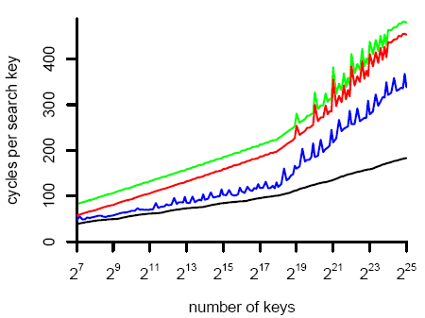
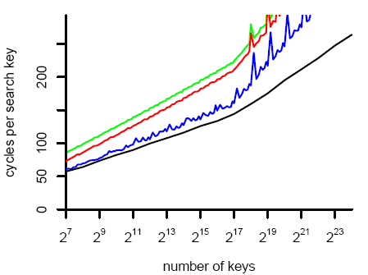
Results: Cell BE SPE
32-bit Integer
64-bit Floating Point
Outcomes
Binary search performs worst
k-ary search on a linearized k-ary search tree performs best
Occurring spikes result from non-aligned DMA-accesses
1.6x
1.3x
2.5x
1.5x

Slide 15
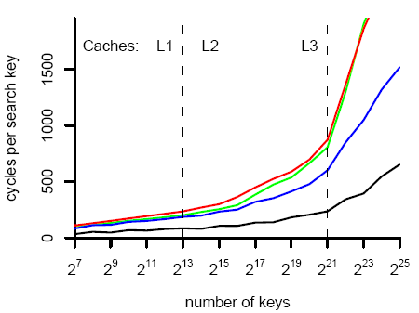
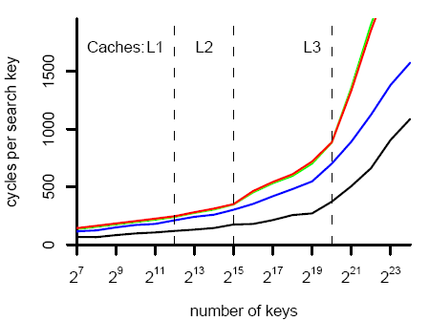
Results: Intel Core i7
32-bit Integer
64-bit Floating Point
Outcomes
Binary search and SIMDized binary search perform similar
Both k-ary search algorithms scale well for a huge number of keys
1.7x
1.5x
2.5x
4x

Slide 16
Agenda
Motivation
Prerequisites
Binary search
SIMDized Binary Search
k-Ary Search
Sorted Array
Linearized k-ary Search Tree
Experiments
Conclusion

Slide 17
Conclusion
Current Situation
Sort-based techniques are important
Modern CPUs provide SIMD instructions
Our Contribution
k-ary search on Modern Processors
Expected Future Scaling
Number of keys | 2¹⁰ | 2¹⁵ | 2²⁰
Binary search | 11 | 16 | 21
SIMDized binary search (k=5) | 9 | 14 | 19
k-ary search (k=5) - SSE | 5 | 7 | 9
k-ary search (k=9) - AVX | 4 | 5 | 7
k-ary search (k=17) - Larrabee | 3 | 4 | 5

Slide 18
k-Ary Search on Modern Processors
Fakultät Informatik, Institut Systemarchitektur, Professur Datenbanken
Sigmod/DaMon 2009
Benjamin Schlegel, Rainer Gemulla, Wolfgang Lehner

