Slide 1
LLMs and Foundation Models für Computer Vision
CS 717 - Seminar

Slide 2
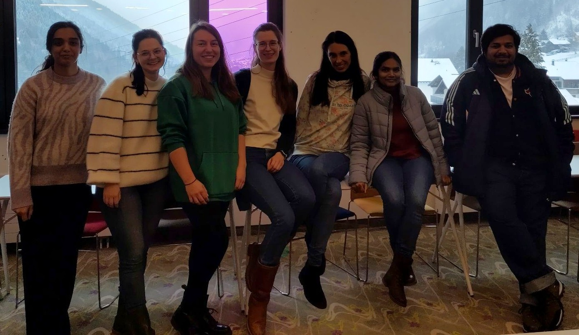
Chair for Machine Learning
DWS Group

Slide 3
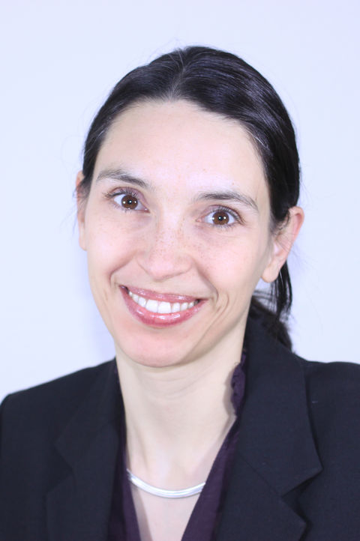
Introduction
Prof. Dr.-Ing. Margret Keuper
Professor for Machine Learning
Research Interests:
Machine Learning and Computer Vision
Video Segmentation
Motion Analysis
Room: B1.15
email: keuper@uni-mannheim.de

Slide 4
Introduction
Steffen Jung
PhD student (currently visiting in USA)
Research Interests:
Image Generation
Learning for Combinatorial
Optimization Problems in Computer Vision
Room: C0.02
email: steffen.jung@mpi-inf.mpg.de

Slide 5
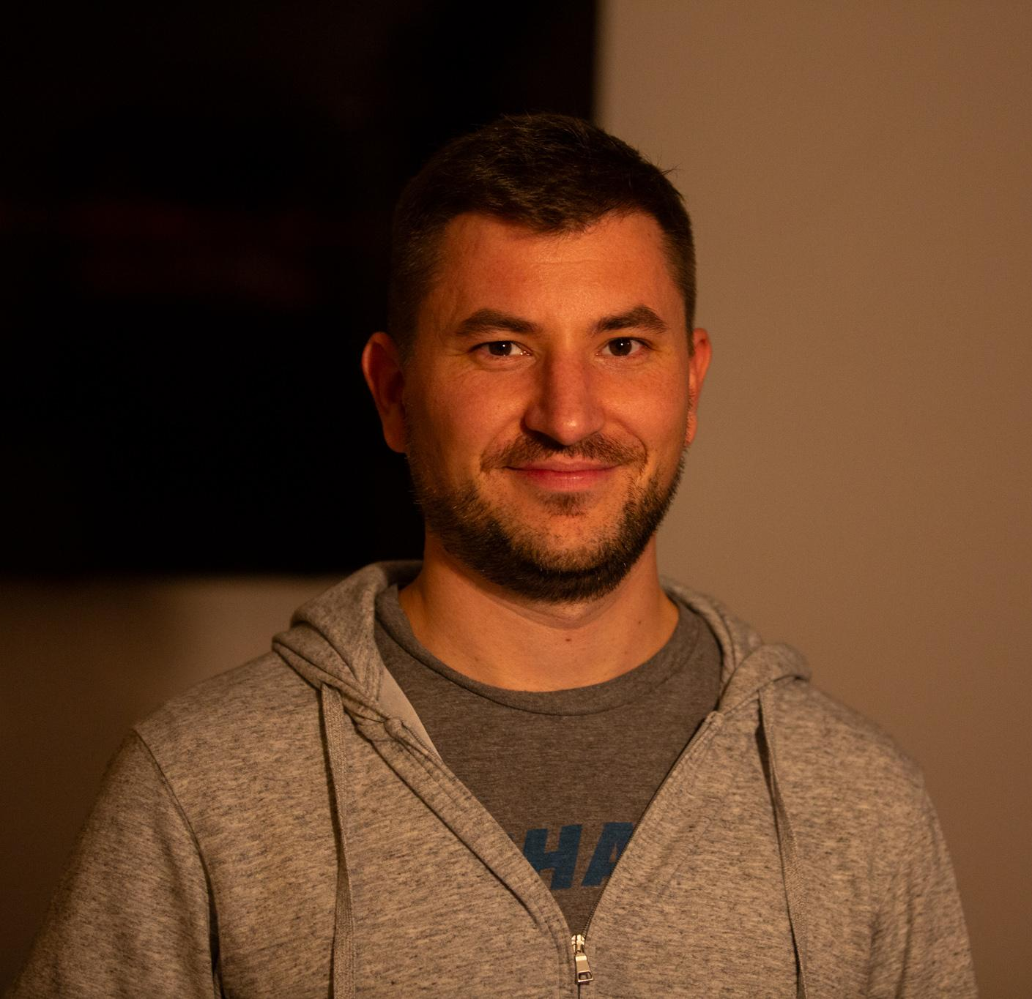
Introduction
Patrick Müller
PhD student
Research Interests:
Optics and Imaging
OOD Robustness
Fractional Fourier Transform
Room: C0.07
email: patrick.mueller.de@gmail.com

Slide 6
Introduction
Julia Grabinski
PhD student
Research Interests:
Robustness of Convolutional Neural Networks
Explainability and Reasoning on CNNs
Room: C0.02
email: julia.grabinski@uni-mannheim.de

Slide 7
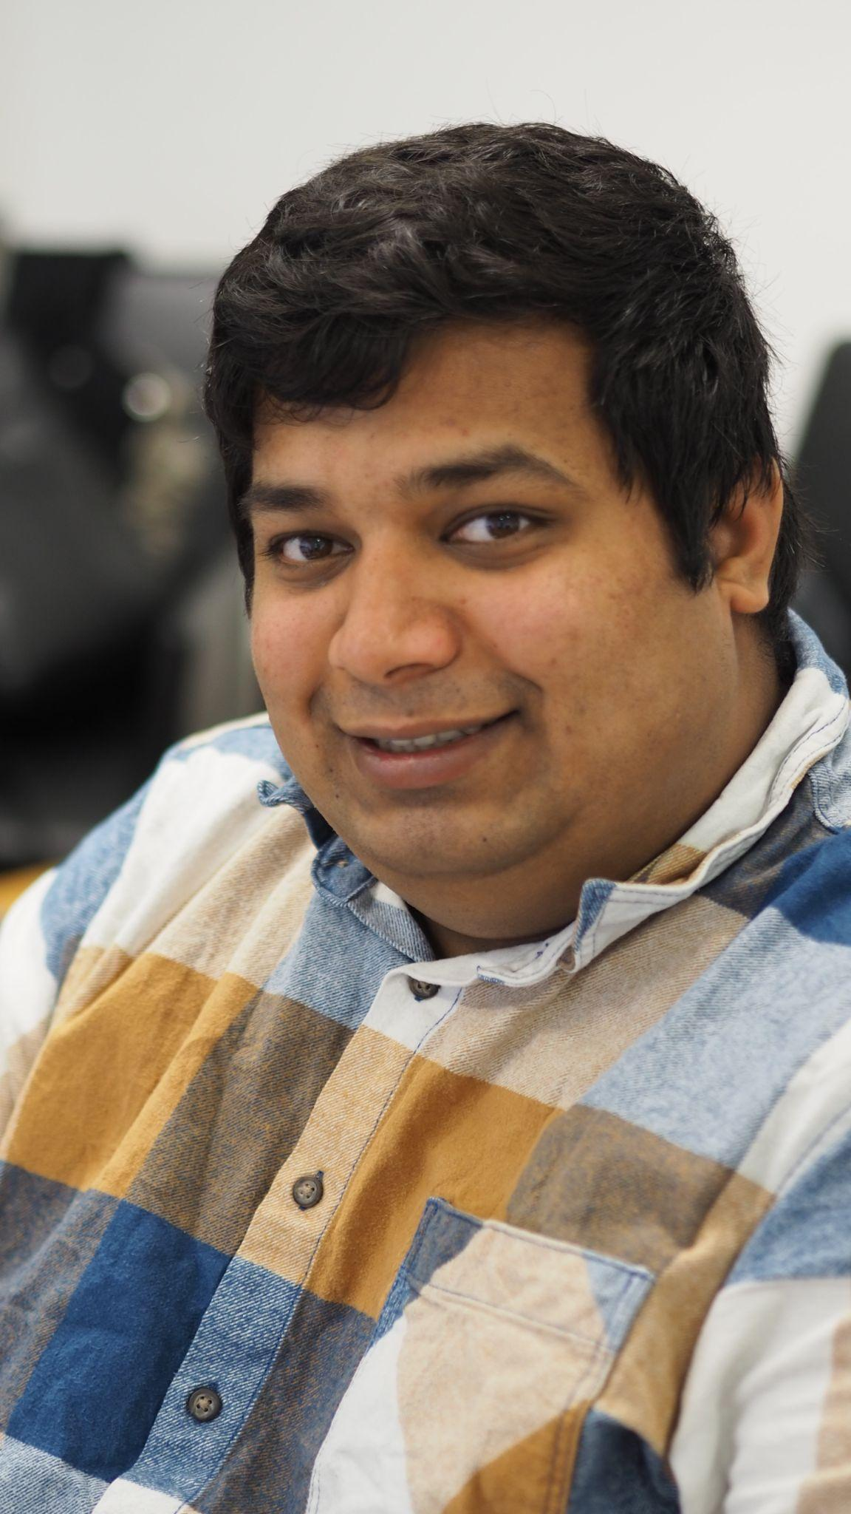
Introduction
Shashank Agnihotri
PhD student
Research Interests:
Robustness of Deep Neural Network Architectures
Network Pruning
Neural Architecture Search
Room: C0.02
email: shashank.agnihotri@uni-mannheim.de

Slide 8
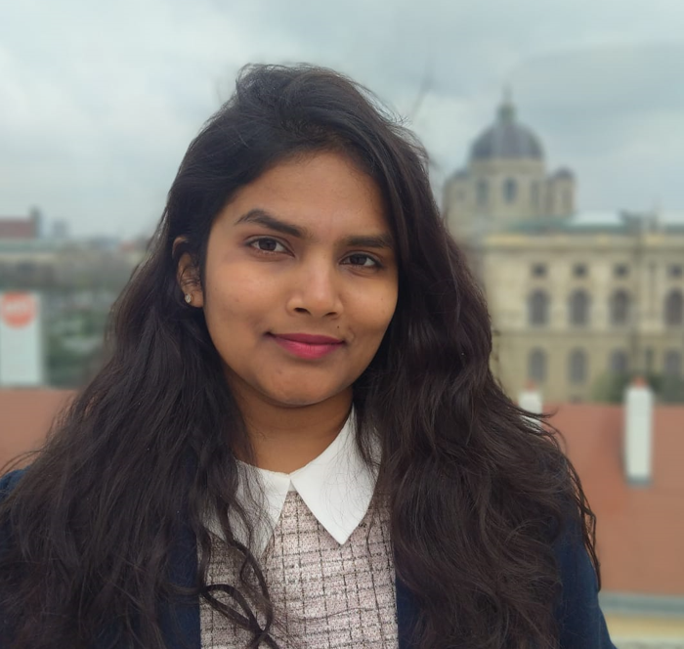
Introduction
Tejaswini Medi
PhD student
Research Interests:
3D Representation Learning
3D Generative Models
Robustness of Deep Neural Networks
Room: C0.01
Email: tejaswini.medi@uni-mannheim.de

Slide 9
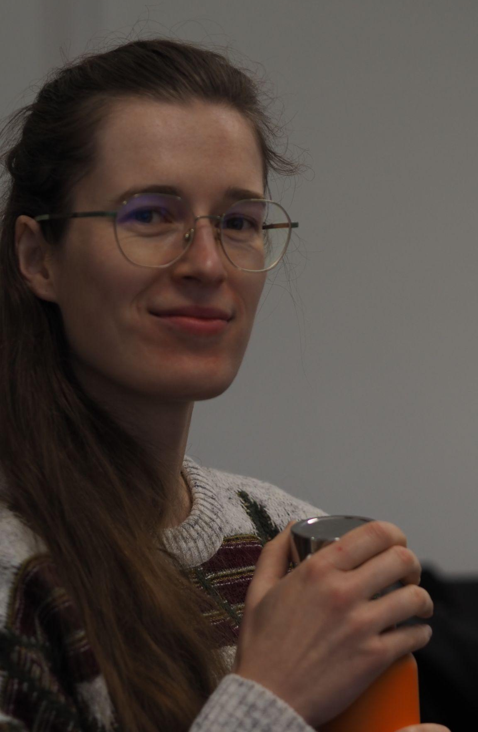
Introduction
Katharina Prasse
PhD student
Research Interests:
Climate Visions
LLMs
Manipulation detection
Room: B0.03
Email: katharina.prasse@uni-mannheim.de

Slide 10
Introduction
Mishal Fatima
PhD student
Research Interests:
Neural Architecture Search
Convex Optimization
Scene Understanding
Room: C0.01
email: mishal.fatima@uni-mannheim.de

Slide 11
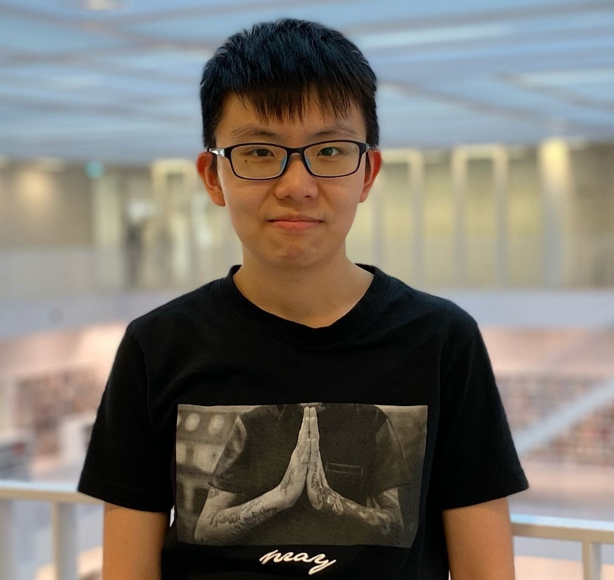
Introduction
Yumeng Li
PhD student
Research Interests:
Generative modelling
Out-of-Distribution Generalization
email: Yumeng.Li@de.bosch.com

Slide 12
Introduction
Jiawen Xu
Visiting PhD student
Research Interests:
Open Set Recognition
Anomaly Detection
email: xgawain@gmail.com

Slide 13
Introduction
Yushi Li
PhD student
Research Interests:
LLMs
Robotic Vision
email: Yushi.Liu2@de.bosch.com

Slide 14
Agenda
Seminar Organization
Seminar Topics
Flash Presentation
Seminar Presentation
How to structure your seminar paper / presentation?
Questions session

Slide 15
Seminar Schedule
Kick-Off Meeting (today)
SELECT PAPERS
Explore literature
Explore relevant literature including your selected paper and relating papers
Schedule a tutor meeting: PLEASE INCLUDE [Seminar on Computer Vision (FSS 2024)] in the email subject
You will be assigned to a tutor, to schedule a meeting you write your tutor an email and make an appointment
Give a summary about your paper and prepare questions
Flash presentation (24th of April tentative)
First submission of report(8th May) & Peer review(15th May):
Schedule a tutor meeting
Final presentation (28th/29th of May tentative)
Hand-in Report(21st of June)
For more details, please look at the schedule on our webpage!

Slide 16
Learning Goals
Read, understand, and explore scientific literature
Summarize a current research topic in a concise report (10 single-column pages + references)
Give two presentations about your topic (3 minutes flash presentation, 15 minutes final presentation)
Moderate a scientific discussion about your topic
Review a (draft of a) report of a fellow student

Slide 17
Formal Requirements
Flash Presentation
3 minutes + 2 minutes discussion and feedback
Presentation
15 minutes + 5 minutes discussion and feedback
Peer review draft of a fellow student (To be assigned by me)
Final Seminar Paper:
10 Pages, single column.
not including bibliography
use latex template of Springer Computer Science Proceedings: http://www.springer.com/de/it-informatik/lncs/conference-proceedings-guidelines
Final grade: 10% flash presentation, 40% presentation, 50% written report.

Slide 18
Agenda
Seminar Organization
Seminar Topics
Flash Presentation
Seminar Presentation
How to structure your seminar paper / presentation?
Questions session

Slide 19
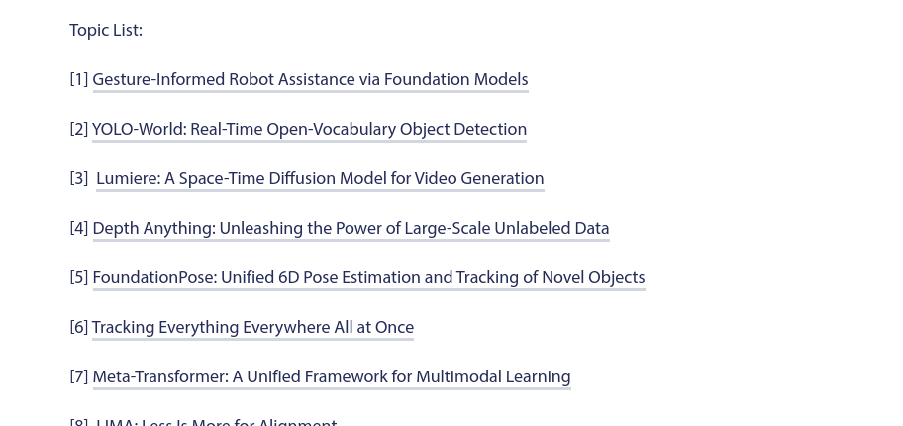
Seminar Topics
This year’s seminar is on LLMs and Foundation Models für Computer Vision.
Each of the papers you select is an entry point to a bigger topic. Your presentation and report should go beyond what is explained in the entry paper and give an impression of the scientific context.

Slide 20
Agenda
Seminar Organization
Seminar Topics
Flash Presentation
Seminar Presentation
How to structure your seminar paper / presentation?
Questions session

Slide 21
Flash Presentation
3 minutes presentation - very short
Not enough time to convey content!
Should introduce the research question and core idea
Should make your fellow student interested in the problem / paper

Slide 22
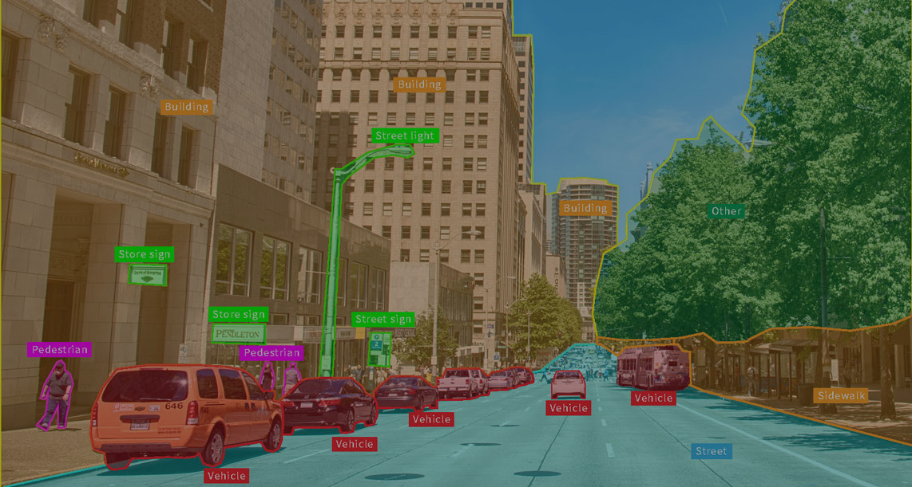
LLMs and Foundation Models for Computer Vision
Presented by: Shashank Agnihotri
Example Flash Presentation

Slide 23
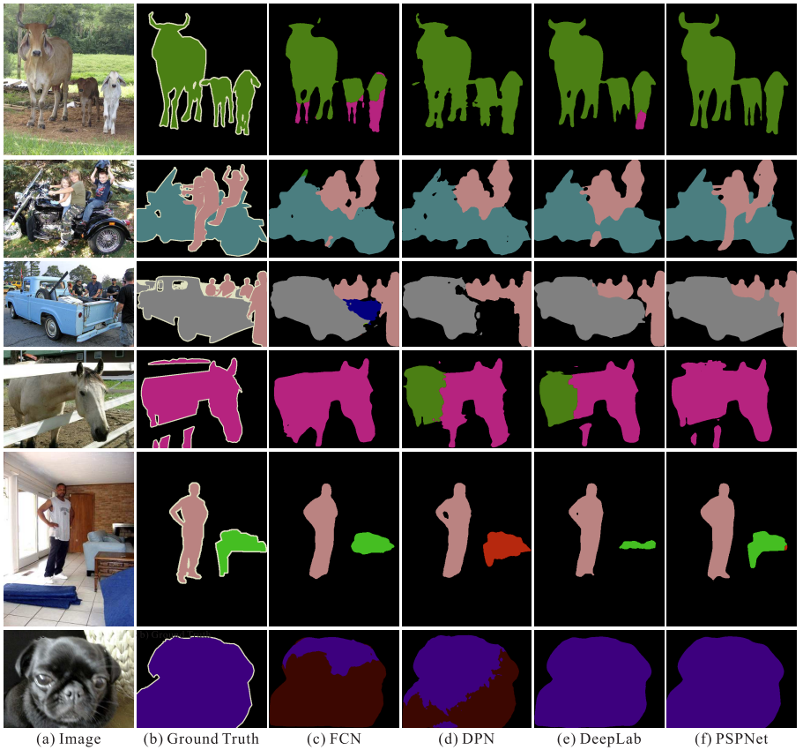
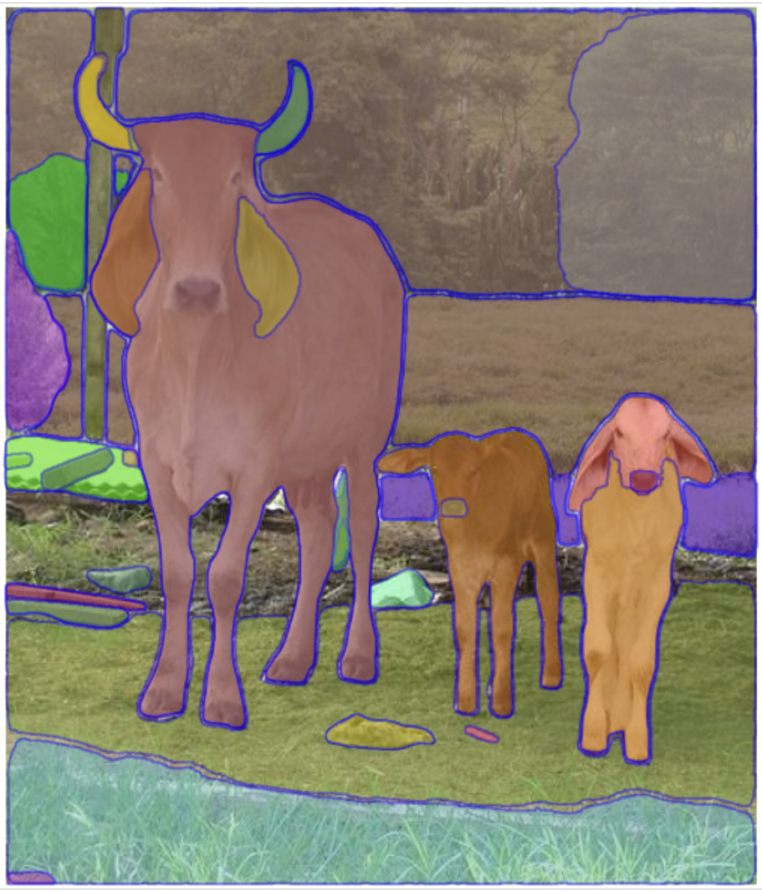
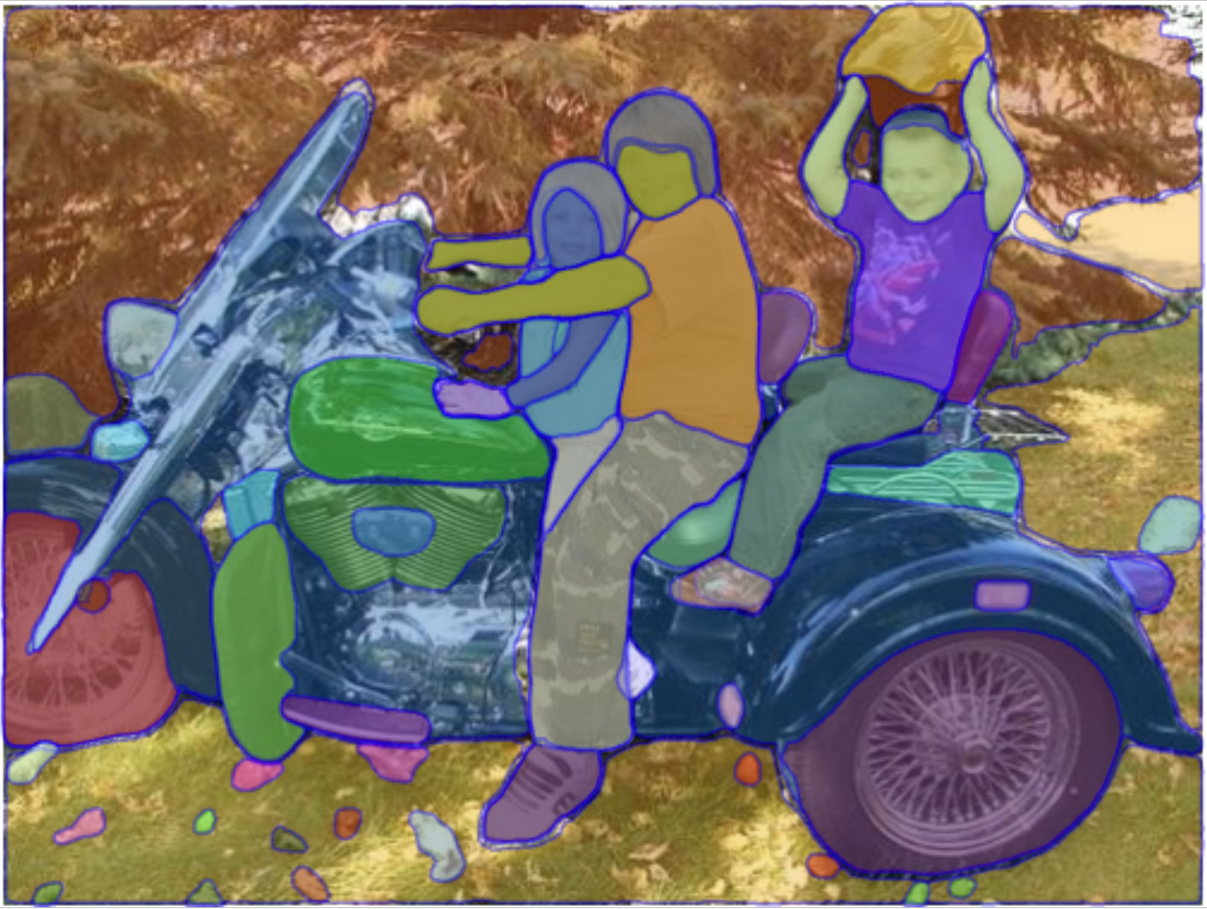
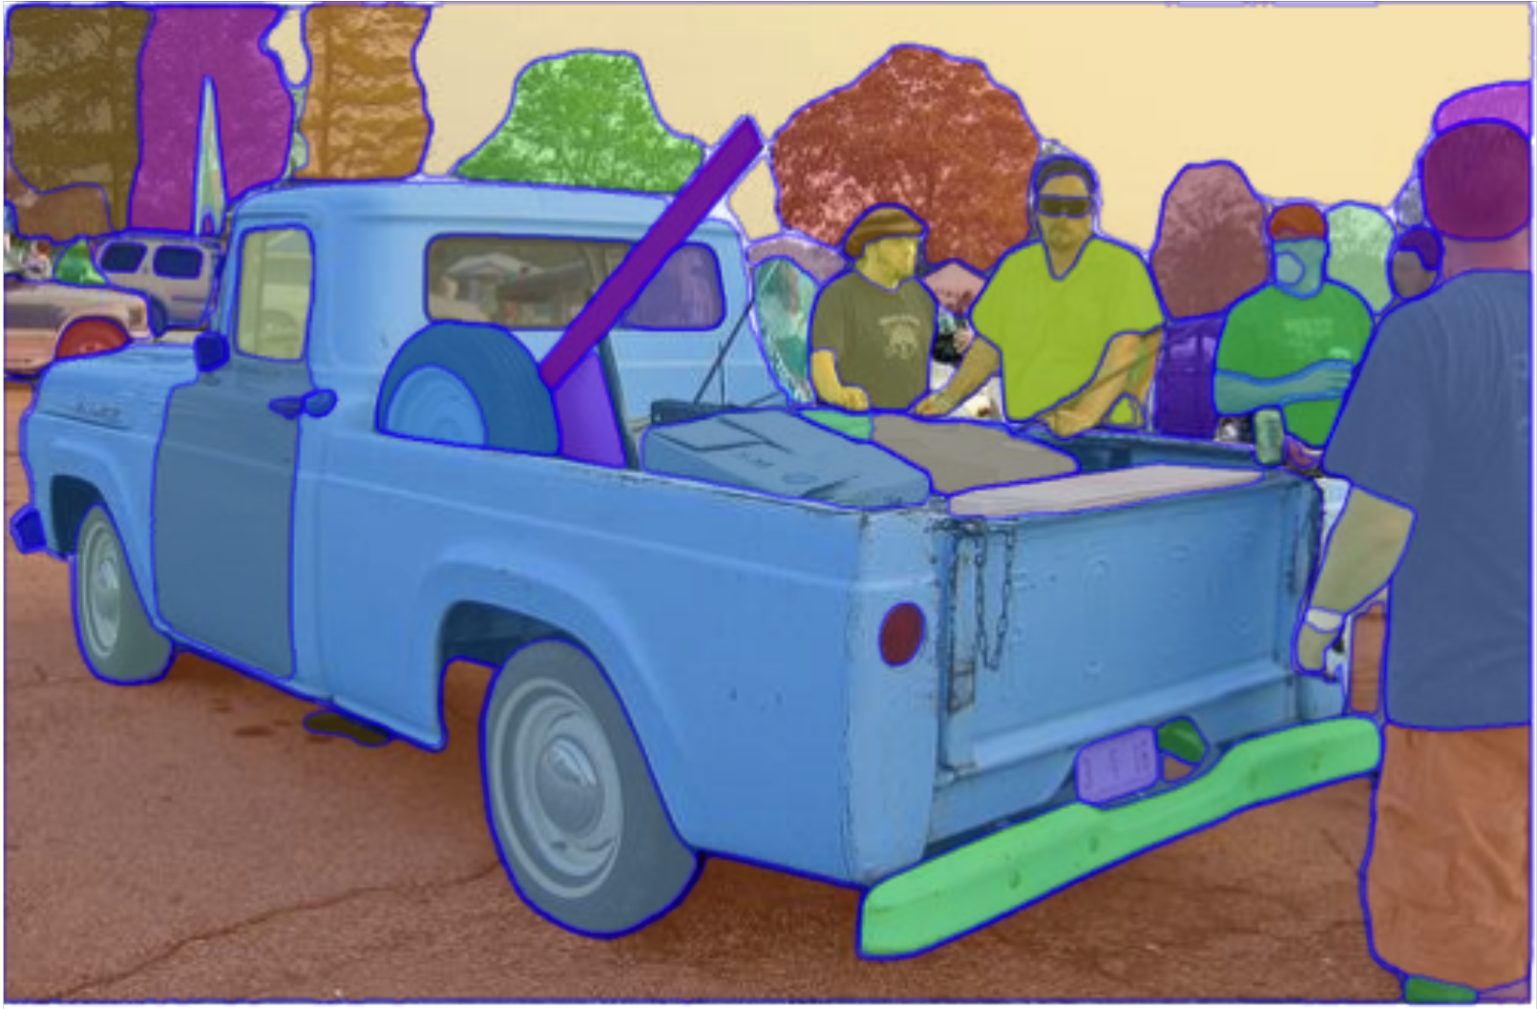
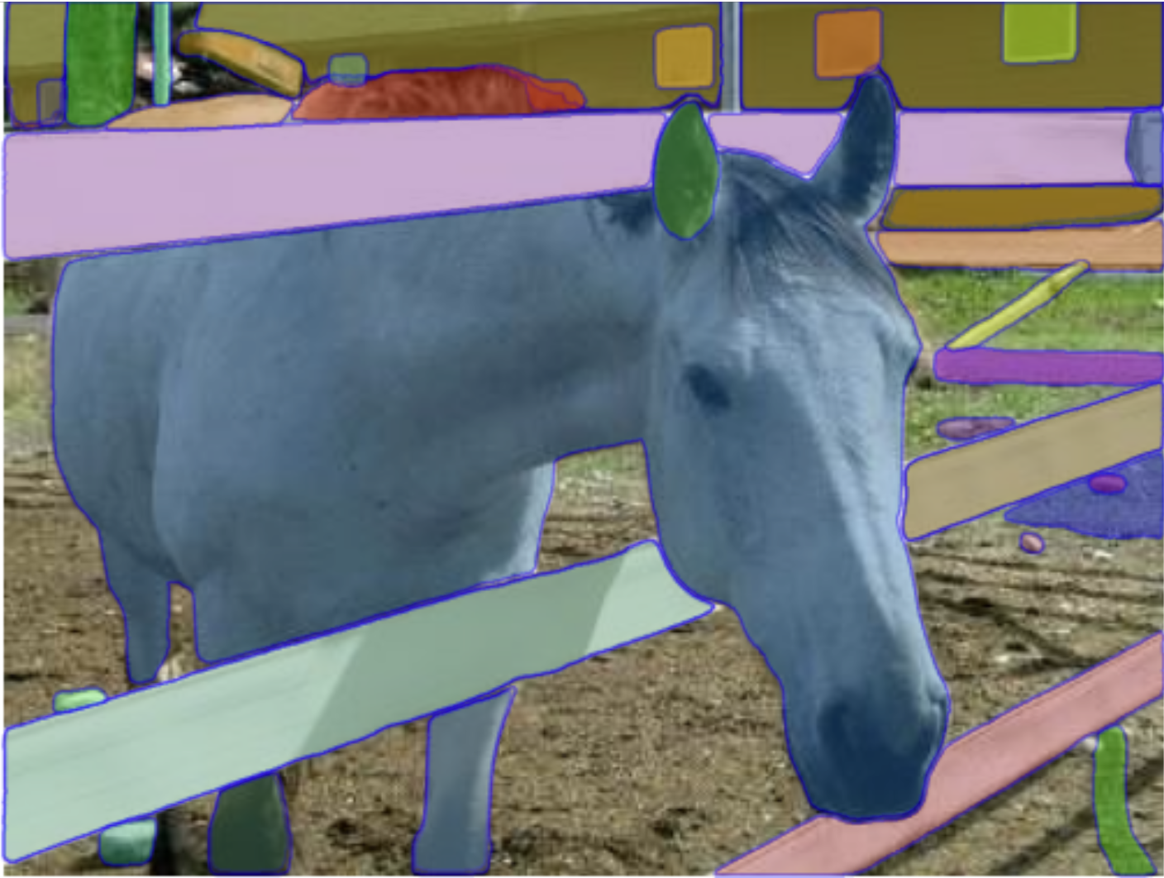
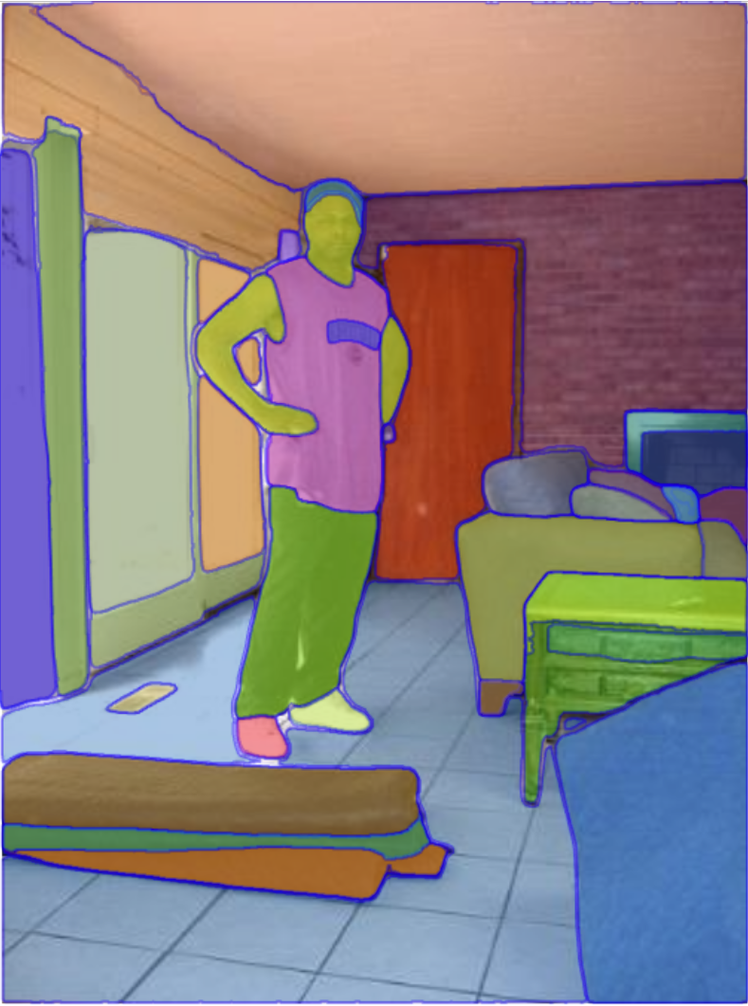
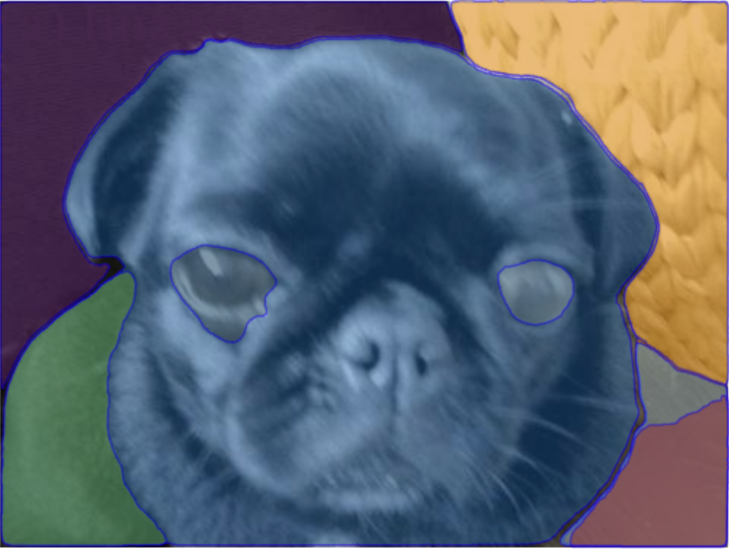
Problems with current vision models
Limited Expectations
Retraining/Finetuning Required
Limited Generalization
SAM
Source: Zhao, Hengshuang, et al. "Pyramid scene parsing network." Proceedings of the IEEE conference on computer vision and pattern recognition. 2017.
Kirillov, Alexander, et al. "Segment anything." arXiv preprint arXiv:2304.02643 (2023).

Slide 24
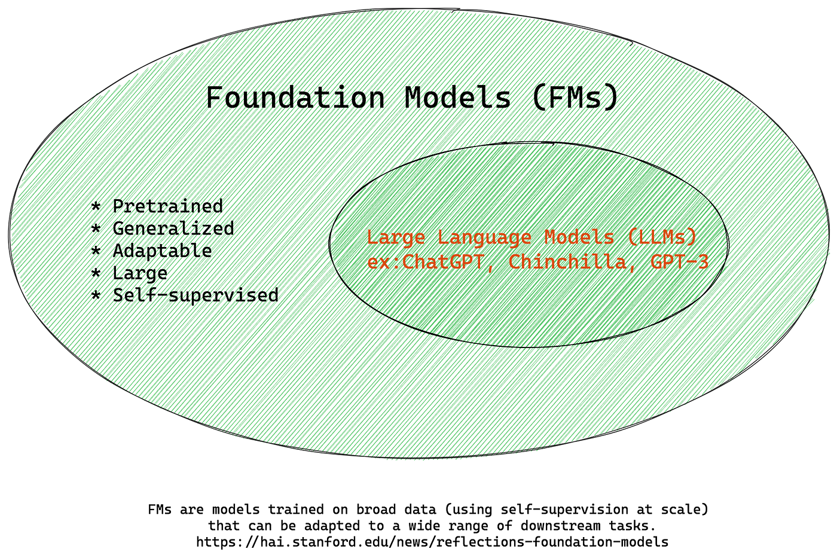
Overview
Source: https://thebabar.medium.com/essential-guide-to-foundation-models-and-large-language-models-27dab58f7404

Slide 25
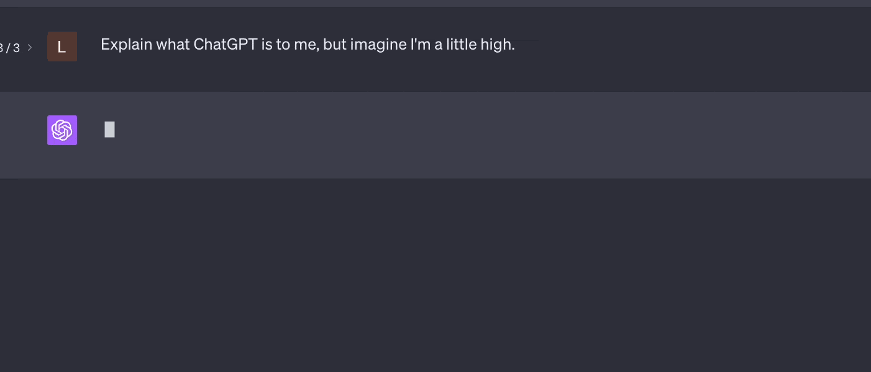
LLMs
Source: https://fernway.com/blog/elevating-the-vibe-how-we-unleashed-the-perfect-high-playlist-using-chatgpt/

Slide 26
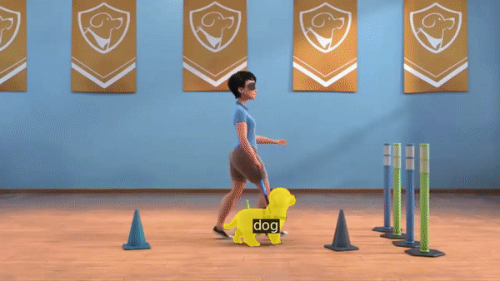
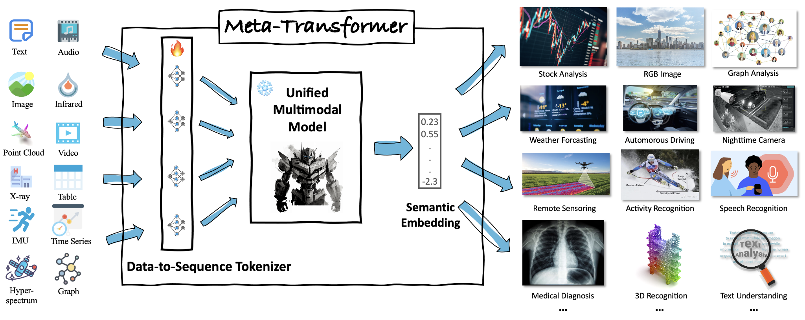
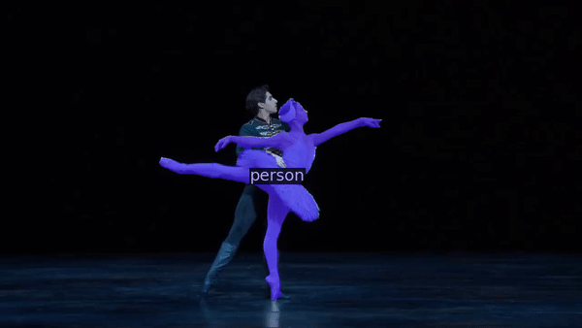
Vision Foundation Models
Source: Zou, Xueyan & Yang, Jianwei & Li, Feng & Li, Linjie & Gao, Jianfeng & Lee, Yong Jae. (2023). Segment Everything Everywhere All at Once.
Zhang, Yiyuan, et al. "Meta-transformer: A unified framework for multimodal learning." arXiv preprint arXiv:2307.10802 (2023).

Slide 27
QUESTIONS?

Slide 28
Agenda
Seminar Organization
Seminar Topics
Flash Presentation
Seminar Presentation
How to structure your seminar paper / presentation?
Questions session

Slide 29
Final Presentation
15 minutes presentation
Enough time to convey content
Should introduce the research question and the approach followed in the entry point paper, alternative approaches, results and discussion

Slide 30
Agenda
Seminar Organization
Seminar Topics
Flash Presentation
Seminar Presentation
How to structure your seminar paper / presentation?
Questions session

Slide 31
How to give a good presentation?
Learn to give a scientific presentation
different from a presentation in professional life where you present your company or product - critical discussion is desired!
Maximize benefit for the audience
Consider structure, layout, design of the presentation
What can be assumed the audience knows? What can’t?
How can we arouse interest in the audience?
Maximize knowledge transfer
Think of your audience – assume you are part of it

Slide 32
How to give a good presentation?
Try to convince, not to persuade
Read and use the literature in a critical way
The authors are almost always right
Read and use different references
Typically, scientific articles are more reliable than information on the Web
You should understand 100% of what you are saying
Use your own words
Do not paraphrase or just translate from other languages
Focus on relevant aspects
Identification of the relevant aspects is the most important point and give additional information or go into details when appropriate
Avoid abbreviations and acronyms

Slide 33
Prepare your presentation
Spell check
Test your presentation
animations, colors, videos, etc.
Complete your preparation on time
Not just the night before…
Practice!
Be prepared for questions
Your answers should show that you are competent!
Be on time the day of the presentation
Take some time to check projector and laptop configuration
What if something does not work?
Be prepared for spontaneous drawings
Clean the blackboard, make sure chalks / markers are available

Slide 34
Seminar Report
A seminar paper differs significantly from a master thesis
The topic is already defined
No need to implement or develop new algorithms
No need to perform new experiments
Primarily: reproduction and re-organization of content that is already available
Goal of seminar paper
Describe the problem
describing and discuss several existing methods for handling the problem, starting from your chosen paper.

Slide 35
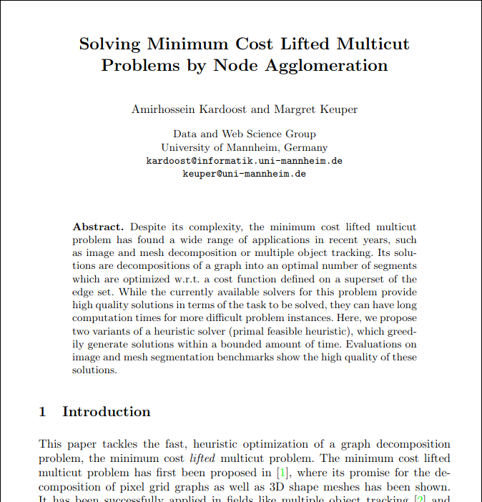
Report Template
LaTex Template

Slide 36
How to structure the report?
Introduction and Problem Statement
Which problem is addressed?
Why is the problem important?
(Structure of your paper)
Description of Existing Approaches
Overview of existing methods
Detailed description of two selected
Evaluation
Comparison and discussion of the used datasets, metrics
Comparison of the evaluation results
Discussion and Conclusion
What do we understand from this paper?
What are the advantages and disadvantages of this paper compared to the literature?
Bibliography

Slide 37
Learn from Examples
Read survey articles and identify the structure from the previous slide
Why can this paragraph be found at that position?
What is the purpose of some section / subsection?
Important
Read survey articles!
Read conference or journal papers.
Use good YouTube videos to understand the work.
Textbook on how to write a thesis
Zobel: Writing for Computer Science, 3rd Edition, Springer 2014.

Slide 38
Citing Different Types of Publications
Journal article
Good to cite, current research results
Survey articles (very good for an overview)
Conference and workshop paper
Good to cite, current research results
Books (sometimes cited)
Textbooks
Collections of articles/papers => Cite specific paper in book
Websites
better not cited from,
Wikipedia is not an exception!!! Do not cite Wikipedia!
Slide sets
Never cite from slide sets

Slide 39
How to find related publications?
Use Standard Search Engines
use Google Scholar
we use it a lot ourselves
Exploit references: Given a relevant document x
Follow references in the past: papers y that x has cited
Follow references in the future: paper y that cited x („cited by” functionality in Google scholar)

Slide 40
Agenda
Seminar Organization
Seminar Topics
Flash Presentation
Seminar Presentation
How to structure your seminar paper / presentation?
Questions session

Slide 41
QUESTIONS?
Please email: shashank.agnihotri@uni-mannheim.de for any further organisational questions.

