Slide 1
Seminar on Award Winning Works
Kick-off Meeting

Slide 2
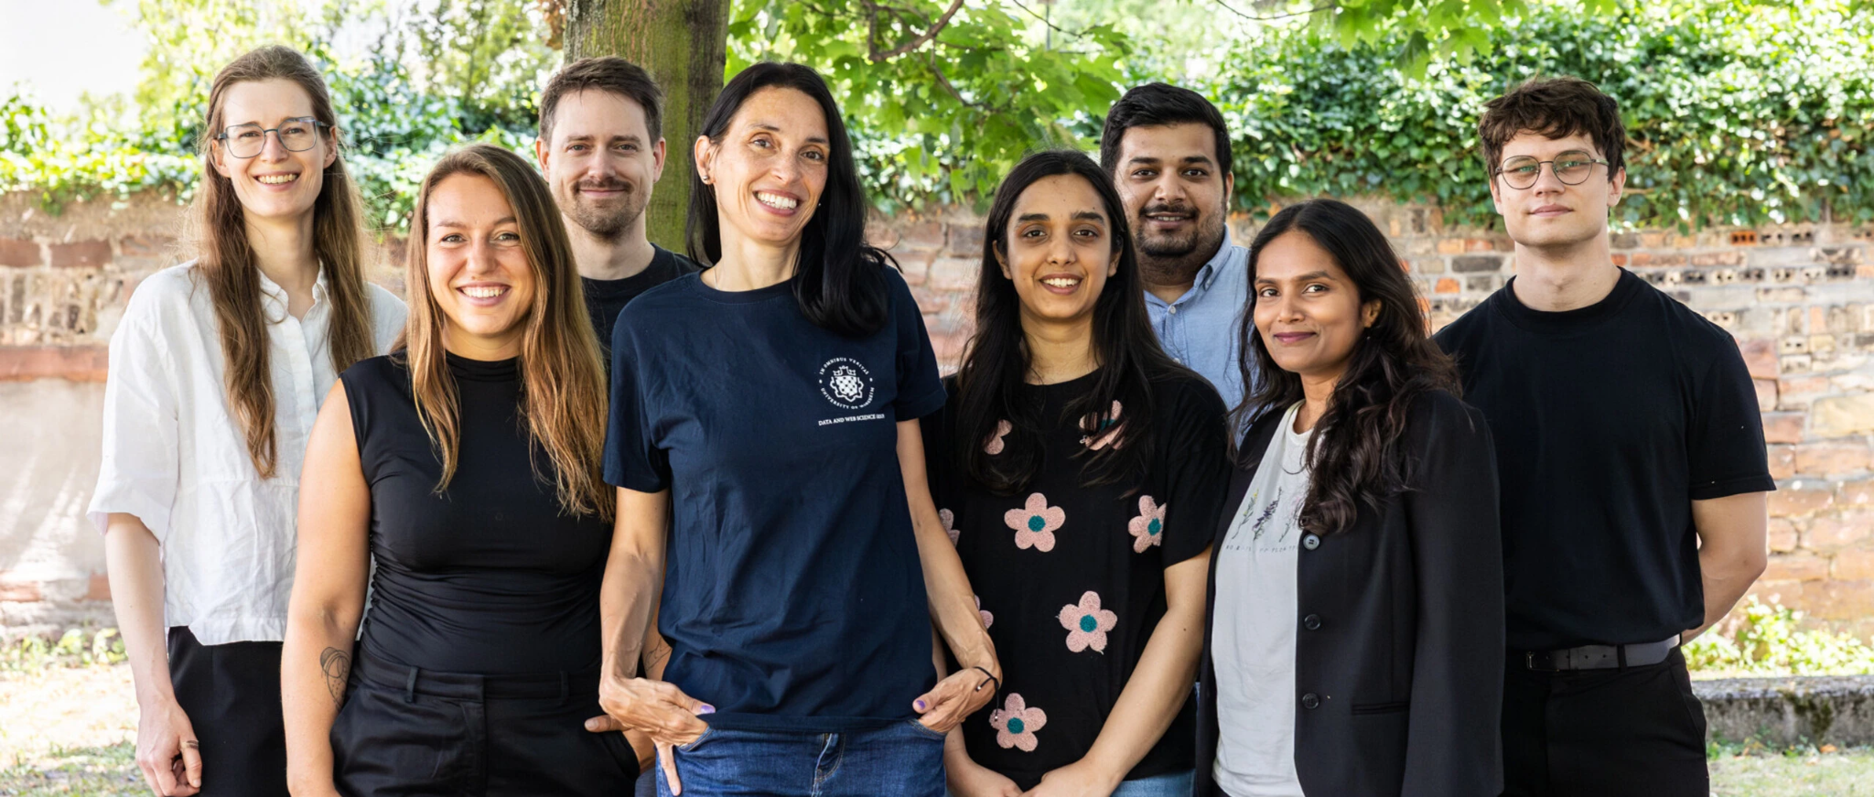
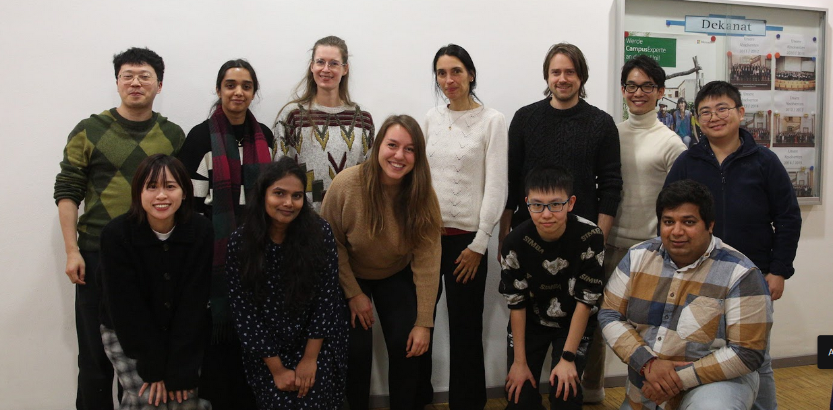
Chair for Machine Learning
DWS Group Our webpage

Slide 3
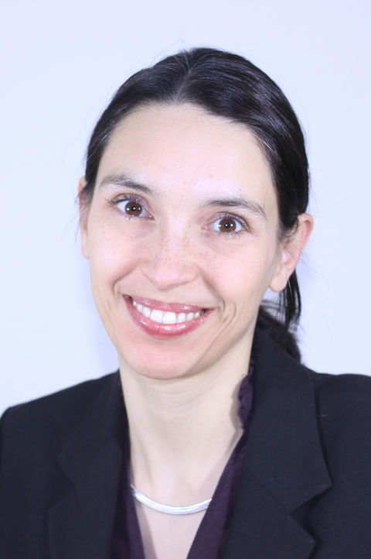
Introduction
Prof. Dr.-Ing. Margret Keuper
Professor for Machine Learning
Research Interests:
  Machine Learning and Computer Vision
  Video Segmentation
  Motion Analysis
  Neural Architecture Search & Robustness
Room: B1.18
Email: keuper@uni-mannheim.de

Slide 4

Introduction
Dr. Steffen Jung
PostDoc
Research Interests:
  Image Synthesis
  Safety & Robustness
  Foundation Models
  Multiple Object Tracking
  Combinatorial Optimization
Room: C0.07
Email: steffen.jung@uni-mannheim.de

Slide 5
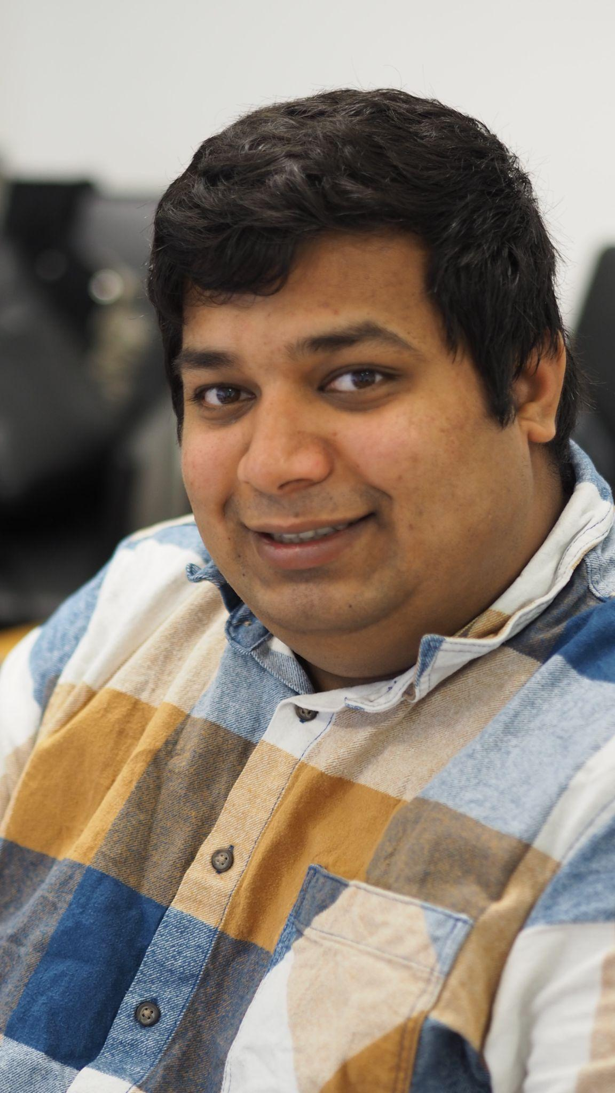
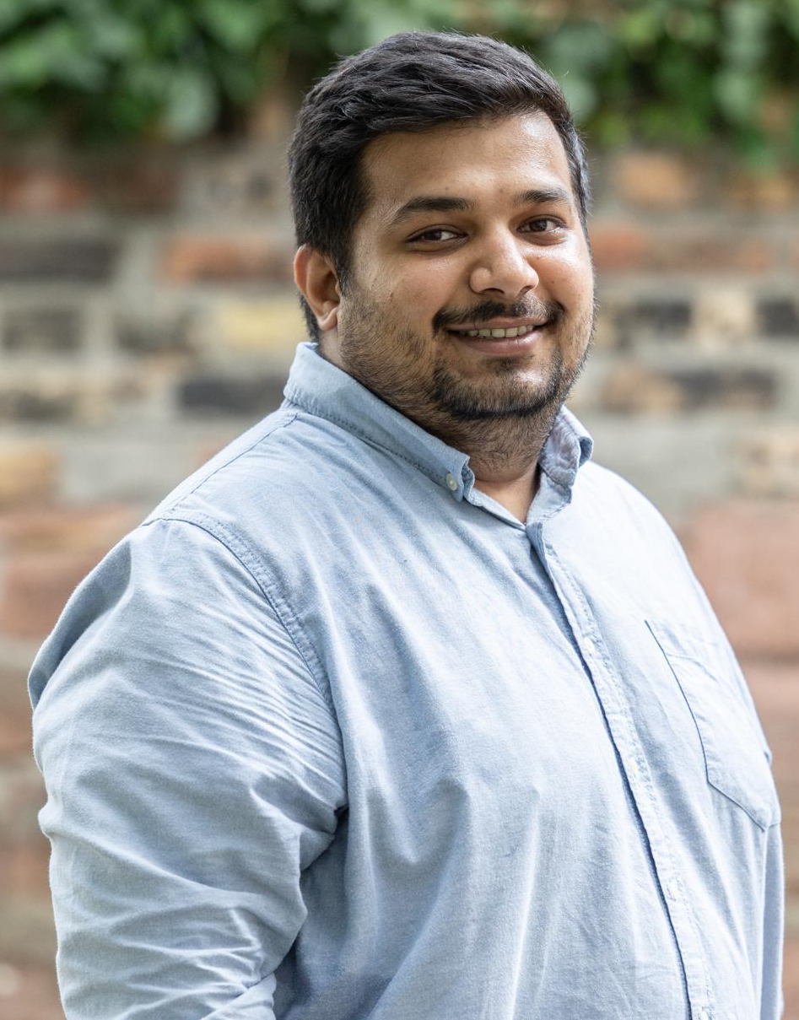
Introduction
Shashank Agnihotri
PhD student
Research Interests:
  Robustness of Deep Neural Network Architectures
  Network Pruning
  Neural Architecture Search
  Vision Foundation Models
  Safety in LLMs and VLMs
Room: C0.02
Email: shashank.agnihotri@uni-mannheim.de

Slide 6
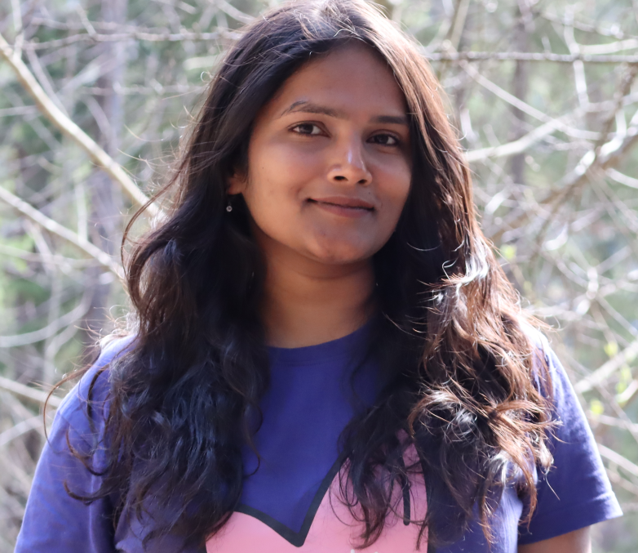
Introduction
Tejaswini Medi
PhD student
Research Interests:
  Adversarial Robustness & Fairness
  Generative Models
  Representational Learning
Room: C0.01
Email: tejaswini.medi@uni-mannheim.de

Slide 7
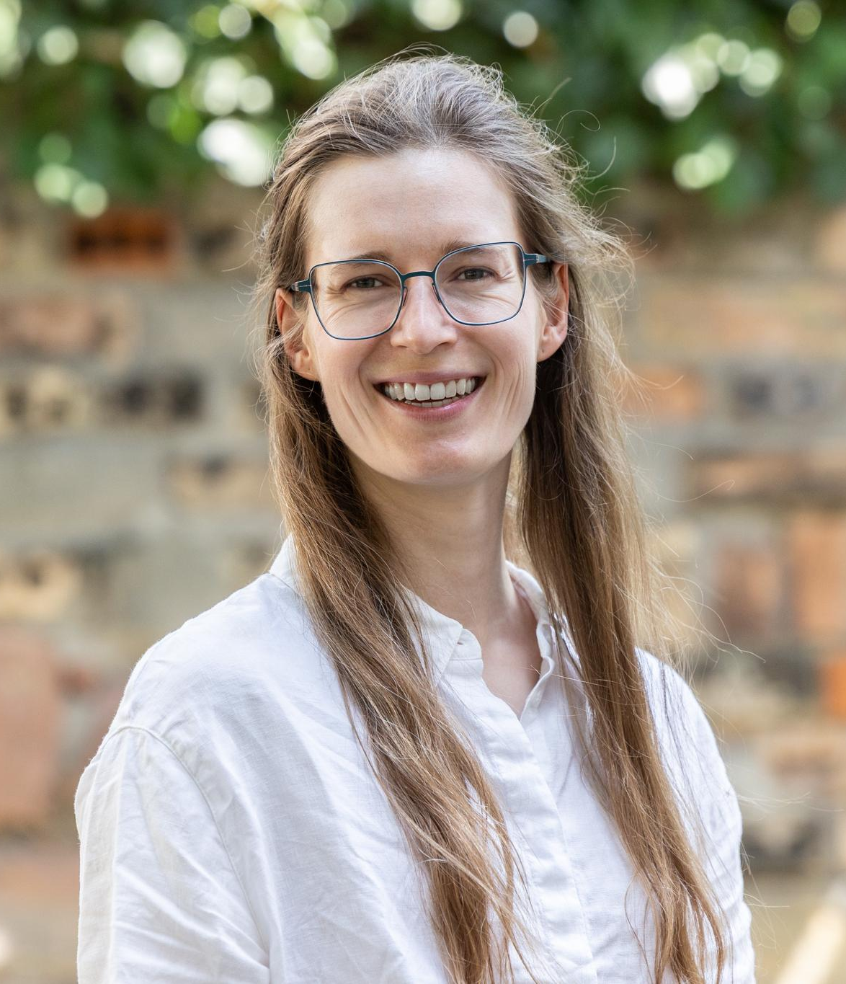
Introduction
Katharina Prasse
PhD student
Research Interests:
  Classification on abstract classes
  Clustering
  Manipulation Detection
  Interpretability
Room: B0.03
Email: katharina.prasse@uni-mannheim.de

Slide 8
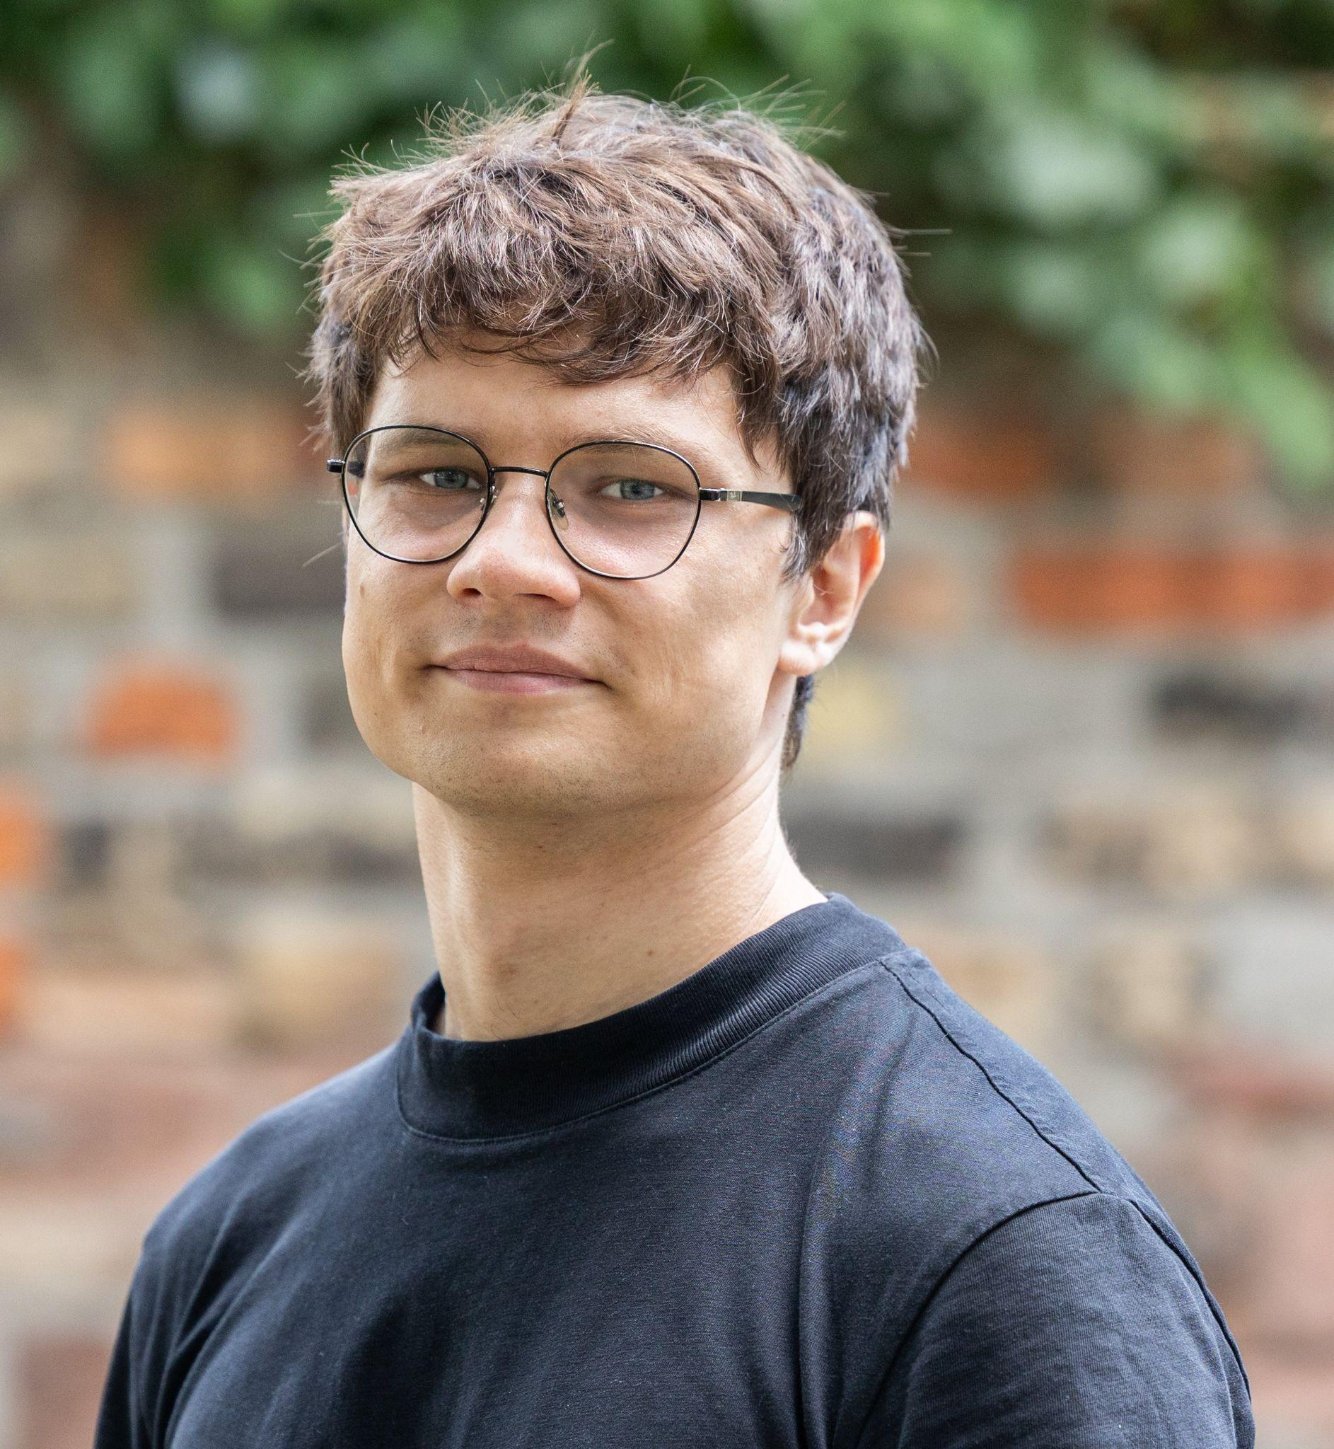
Introduction
Max Kahl
PhD student
Research Interests:
  Deep learning for Combinatorial Optimization
  Prior Data Fitted Networks
  Riemannian Optimization
Room: C0.02
Email: mkahl@mpi-inf.mpg.de
Wants CVPR in Siegen

Slide 9
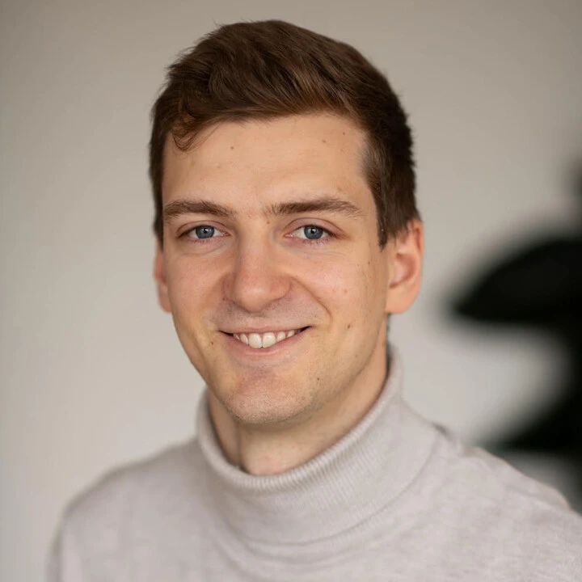
Introduction
Fabian Rösch
PhD student
Research Interests:
- Explainability and Interpretability
- Stereo Matching
Room: C0.01
Email: fabian.roesch@uni-mannheim.de

Slide 10
Agenda
Seminar Organization
Seminar Topics
Flash Presentation
Seminar Presentation
How to structure your seminar paper / presentation?
Questions session

Slide 11
Seminar Schedule
Kick-Off Meeting (today)
Recurring meeting: Tuesdays, 17:15.
Select papers
  Masters Seminar Webpage
  Bachelors Seminar Webpage
Explore literature
  Explore relevant literature including your selected paper and related papers.
Schedule a tutor meeting: PLEASE INCLUDE [CS717/SM459 Seminar] in the email subject
  You will be assigned to a tutor.
  To schedule a meeting: you write your tutor an email and make an appointment.
  Give a summary about your paper/chapter and prepare questions.

Slide 12
Learning Goals
Read, understand, and explore scientific literature.
Give two presentations about your topic (3 minutes flash presentation, 15 minutes final/detailed presentation).
Summarize a current research topic in a concise report (10 single-column pages + references).
Moderate a scientific discussion about your topic.
Review a (manuscript of a) report of a fellow student.

Slide 13
Seminar Schedule
Important Dates
Mock Flash Presentations: October 06
Flash Presentations: October 20
First Submission of Report: October 27
Peer Review: November 10
Discussing Peer Review: November 17
Detailed Presentations: December 01
Hand-in Report: December 23

Slide 14
Formal Requirements
Flash Presentation
  3 minutes + 2 minutes discussion and feedback. Being overtime would be penalized!
Detailed Presentation
  15 minutes + 5 minutes discussion and feedback. Being overtime would be penalized!
Peer review manuscript of a fellow student (we will provide a questionnaire)
Final Seminar Paper:
  10 Pages, single column. (Not including bibliography)
  Use latex template of Springer Computer Science Proceedings.
Final grade: 10% flash presentation, 40% presentation, 50% written report.
Please contact your supervisor after each grading stage for feedback!

Slide 15
Overtime Penalties
Flash Presentation
  heavy penalty over 10 seconds.
Final Presentation
  up to 1 min: -0.3
  1 min - 2 mins: -0.7
  2 mins - 3 mins: -1.0
  …

Slide 16
Agenda
Seminar Organization
Seminar Topics
Flash Presentation
Seminar Presentation
How to structure your seminar paper / presentation?
Questions session

Slide 17
Seminar Topics
Theme: Award Winning Works
🔹 Paper is selected from the provided list.
Beyond the Paper:
Each selected paper serves as an entry point into broader scientific discussions.
The presentation and report will explore the larger research landscape, highlighting advancements, challenges, and future directions.

Slide 18
Seminar Topics
Paper | Supervisor
Minimalist Vision with Freeform Pixels | Tejaswini Medi
On the Versatile Uses of Partial Distance Correlation in Deep Learning | Prof. Dr.-Ing Margret Keuper
On the duality between contrastive and non-contrastive self-supervised learning | Fabian Rösch
Comparing the Decision-Making Mechanisms by Transformers and CNNs via Explanation Methods | Dr. Steffen Jung
Generalization in Diffusion Models Arises from Geometry-Adaptive Harmonic Representations | Max Kahl
NitroGen: An Open Foundation Model for Generalist Gaming Agents | Shashank Agnihotri
ChordEdit: One-Step Low-Energy Transport for Image Editing | Katharina Prasse
Navigation World Models | Max Kahl

Slide 19
Agenda
Seminar Organization
Seminar Topics
Flash Presentation
Seminar Presentation
How to structure your seminar paper / presentation?
Questions session

Slide 20


Flash Presentation
3 minutes presentation - very short
Not enough time to convey content
Should introduce the research question and core idea / chapter
Should make your fellow student interested in the problem / concept

Slide 21
Example Flash Presentation

Slide 22
Flash Presentation
Deep Residual Learning for Image Recognition
Authors: Kaiming He, Xiangyu Zhang, Shaoqing Ren, Jian Sun.
Published at: CVPR 2016
Awards: CVPR 2026 Longuet-Higgings Prize
Presented By: Shashank Agnihotri

Slide 23

How Feature Extraction Works

Slide 24

How Feature Extraction Works

Slide 25
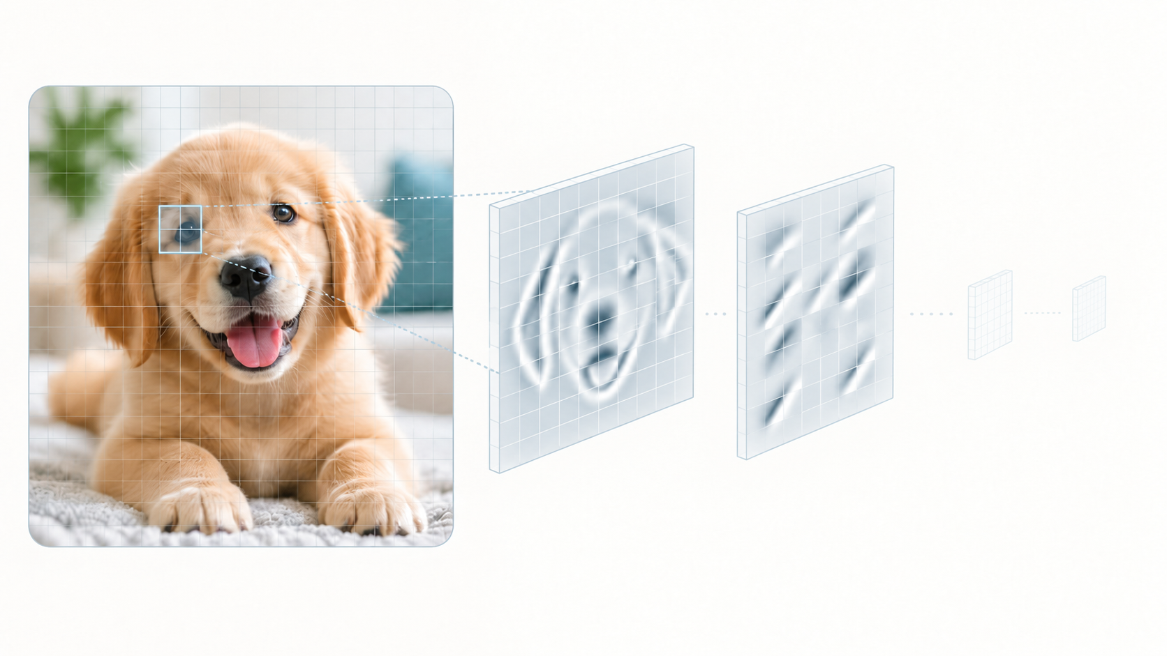
How Feature Extraction Works

Slide 26
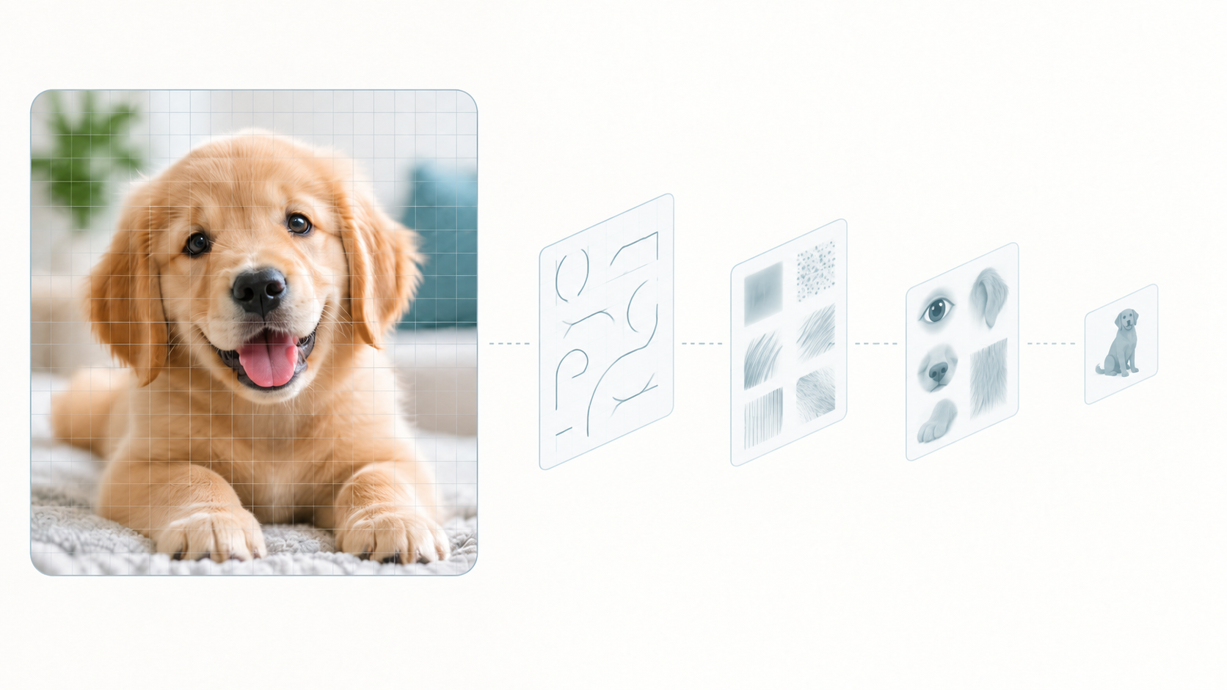
How Feature Extraction Works

Slide 27
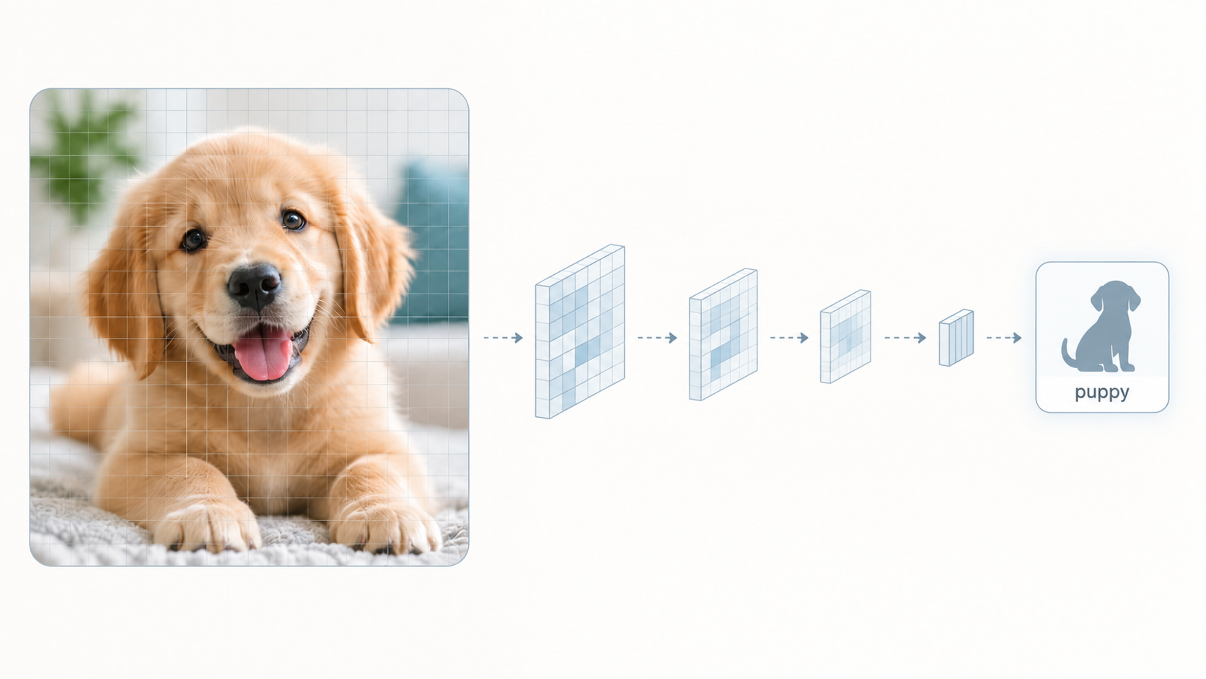
How Feature Extraction Works

Slide 28
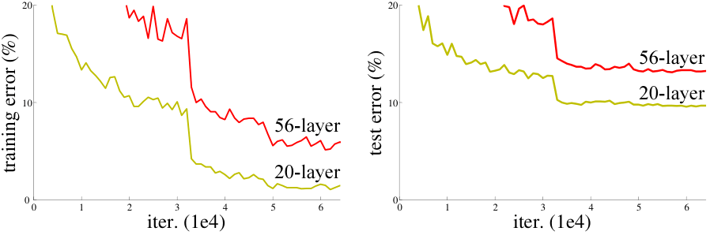
What Goes Wrong?

Slide 29
What Goes Wrong?

Slide 30

The Solution: Residual Connections!

Slide 31
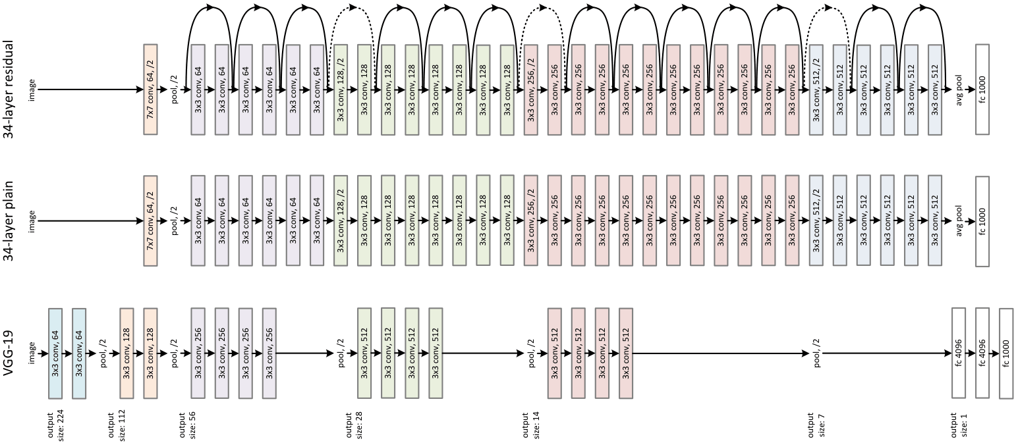
The Solution: Residual Connections!

Slide 32
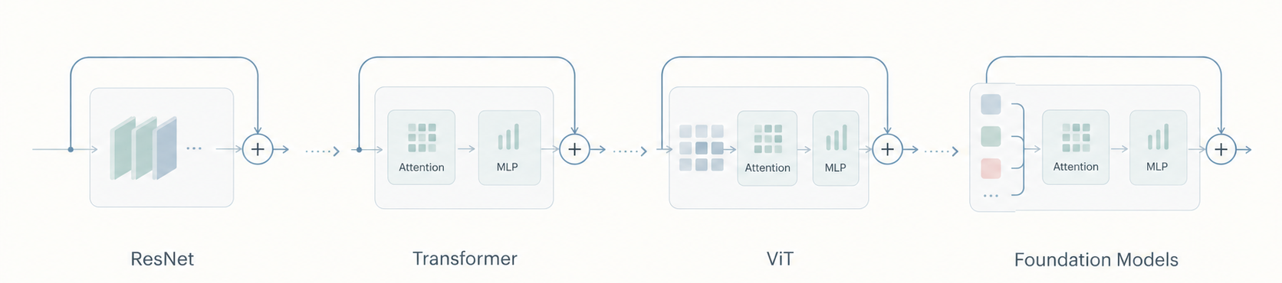
The Shortcut Remained!

Slide 33

Questions?

Slide 34
Agenda
Seminar Organization
Seminar Topics
Flash Presentation
Detailed Presentation
How to structure your seminar paper / presentation?
Questions session

Slide 35
Detailed Presentation
15 minutes presentation
Enough time to convey content
Master Students: Should introduce the research question and the approach followed in the entry point paper, alternative approaches, results and discussion.
Bachelor Students: Give a keen understanding of the fundamental topic provided.

Slide 36
Agenda
Seminar Organization
Seminar Topics
Flash Presentation
Seminar Presentation
How to structure your seminar report / presentation?
Questions session

Slide 37
How to give a good presentation?
Learn to give a scientific presentation
  Different from a presentation in professional life where you present your company or product-critical discussion is desired!
Maximize benefit for the audience
  Consider structure, layout, design of the presentation.
  What can be assumed the audience knows? What can’t?
  How can we arouse interest in the audience?
  Maximize knowledge transfer.
  Think of your audience – assume you are part of it

Slide 38
How to give a good presentation?
Try to convince, not to persuade.
Read and use the literature in a critical way .
Read and use different references
  Typically, scientific articles are more reliable than information on the Web
You should understand 100% of what you are saying.
Use your own words
  Do not paraphrase or just translate from other languages
Focus on relevant aspects
  Identification of the relevant aspects is the most important point and give additional information or go into details when appropriate
Avoid abbreviations and acronyms.

Slide 39
How to give a good presentation?
Avoid too much content on a single slide - this can be overwhelming.
Avoid spelling mistakes - they can be distracting.
Find or create appropriate illustrations for the core messages. Often, a single image is more informative than text.

Slide 40
Prepare your Presentation
Test your presentation
  animations, colors, videos, etc.
Complete your preparation on time (Not just the night before…)
Practice!
Be prepared for questions
  Your answers should show that you are competent!
Be on time the day of the presentation
  Take some time to check projector and laptop configuration
  What if something does not work?
Be prepared for spontaneous drawings
Clean the blackboard, make sure chalks / markers are available

Slide 41
Seminar Report
A seminar report differs significantly from a master thesis
  The topic is already defined
  No need to implement or develop new algorithms
  No need to perform new experiments
  Primarily: reproduction and re-organization of content that is already available
Goal of seminar paper
  Describe the problem / topic
  Describe and discuss several existing methods for handling the problem, starting from your chosen paper in case of master students

Slide 42

Report Template
LaTex Template

Slide 43
How to structure the report? (Master Students)
Abstract
Introduction and Problem Statement
  Which problem is addressed?
  Why is the topic important?
  (Structure of your paper)
Description of Existing Approaches
  Overview of the paper in detail
  Overview of existing methods
  Detailed description of two selected
Evaluation
  Comparison and discussion of the used datasets, metrics
  Comparison of the evaluation results
Discussion and Conclusion
  What do we understand from this paper?
  What are the advantages and disadvantages of this paper compared to the literature?
Bibliography

Slide 44
How to structure the report? (Bachelor Students)
Abstract
Introduction of the fundamental topic
  Importance of the topic
  Why is the topic important?
  (Structure of your paper)
Description of fundamental topic
Discussion and Conclusion
  What do we understand from this fundamental topic?
Bibliography

Slide 45
Learn from Examples
Read survey articles and identify the structure from the previous slide
  Why can this paragraph be found at that position?
  What is the purpose of some section / subsection?
Important
  Read survey articles!
  Read conference or journal papers.
  Can help: Watch YouTube videos to understand the work.
Textbook on how to write a thesis
  Zobel: Writing for Computer Science, 3rd Edition, Springer 2014.

Slide 46
Citing Different Types of Publications
Journal article
  Good to cite, current research results
Survey articles (very good for an overview)
Conference and workshop paper
  Good to cite, current research results
Books (sometimes cited)
  Textbooks
  Collections of articles/papers → Cite specific paper in book
Websites
  Better not cited from
  Wikipedia is not an exception!!! Do not cite Wikipedia!
Slide sets
  Never cite from slide sets

Slide 47
How to find related publications?
Use Standard Search Engines
  Use Google Scholar
  We use it a lot ourselves
Exploit references: Given a relevant document x
  Follow references in the past: papers y that x has cited
  Follow references in the future: paper y that cited x („cited by” functionality in Google scholar)

Slide 48
Agenda
Seminar Organization
Seminar Topics
Flash Presentation
Seminar Presentation
How to structure your seminar paper / presentation?
Questions session

Slide 49
IMPORTANT!
THE BURDEN OF INITIATING CONVERSATION WITH THE SUPERVISOR
RELIES ON THE STUDENT.
Please be proactive about it!
And please contact your supervisors well in advance as they too have busy schedules.
Supervisors are here to help you with every stage of the process, please do not shy away from contacting them, especially for getting feedback.

Slide 50
QUESTIONS?
Please email: shashank.agnihotri@uni-mannheim.de for any further organisational questions.

